Slide 1
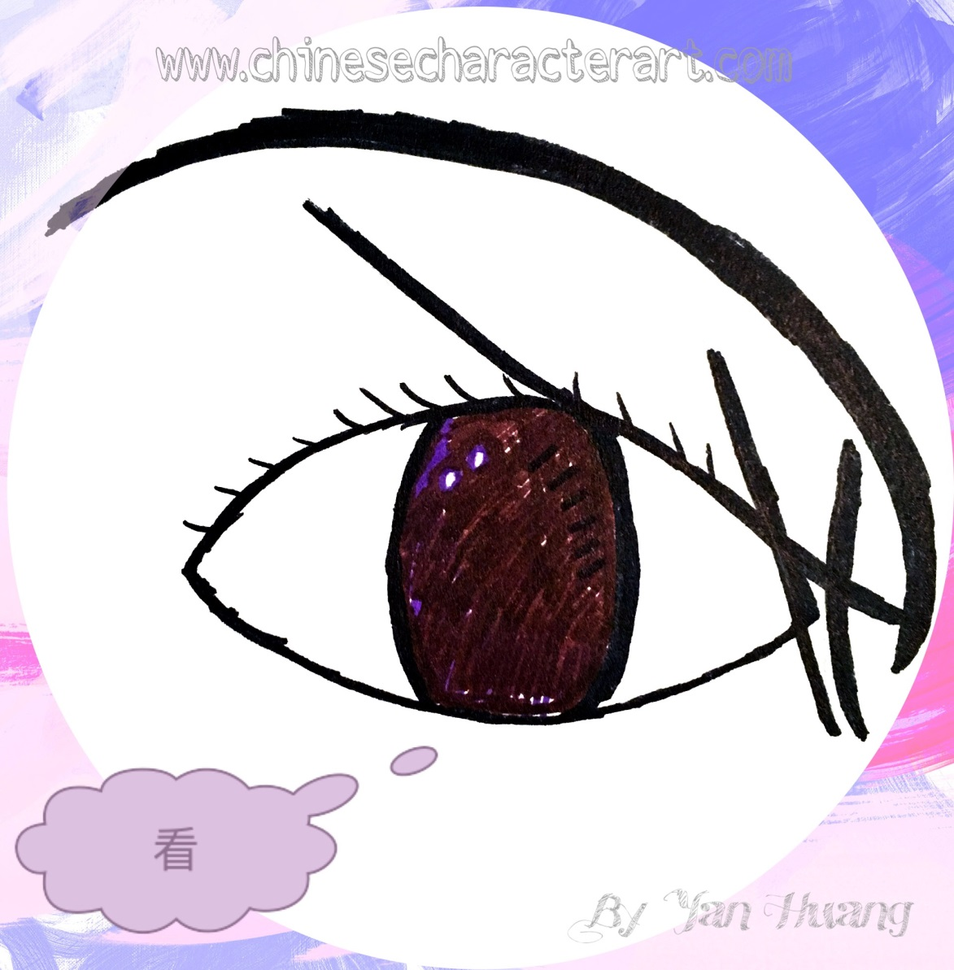
看Kàn
To look; to see

Slide 2
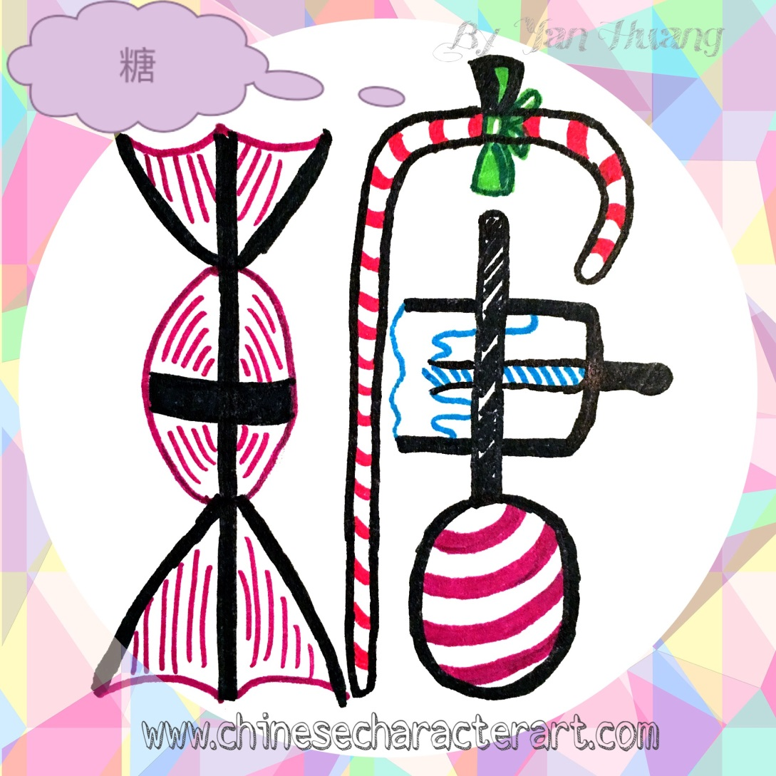
糖Táng
Candy; sugar

Slide 3
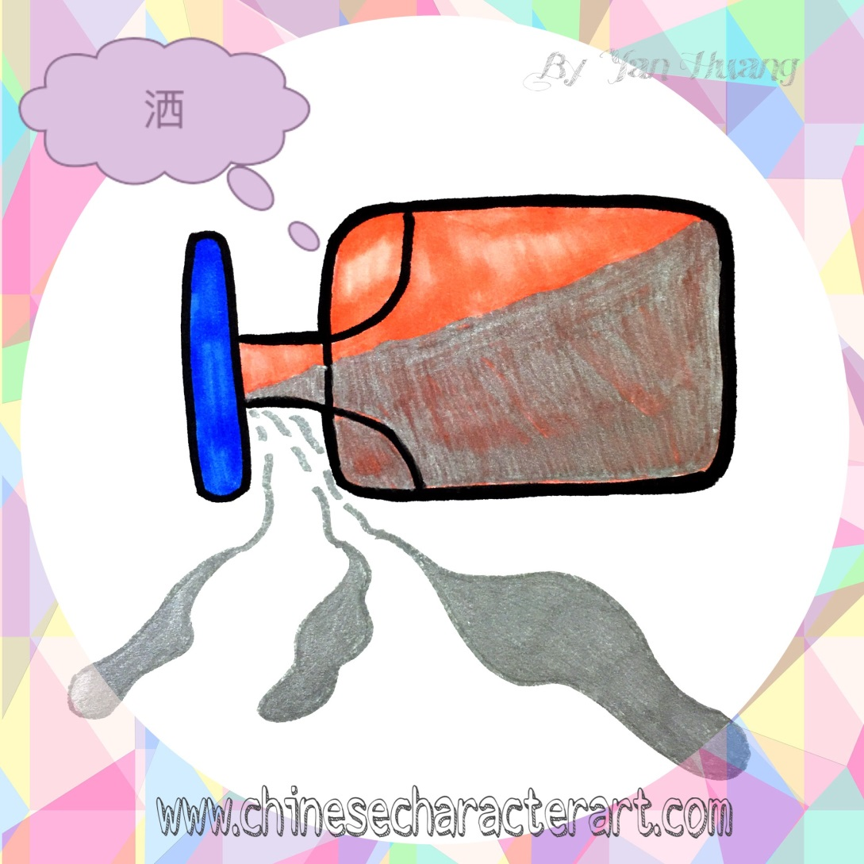
洒Sǎ
To spill

Slide 4

牛Niú
cow

Slide 5
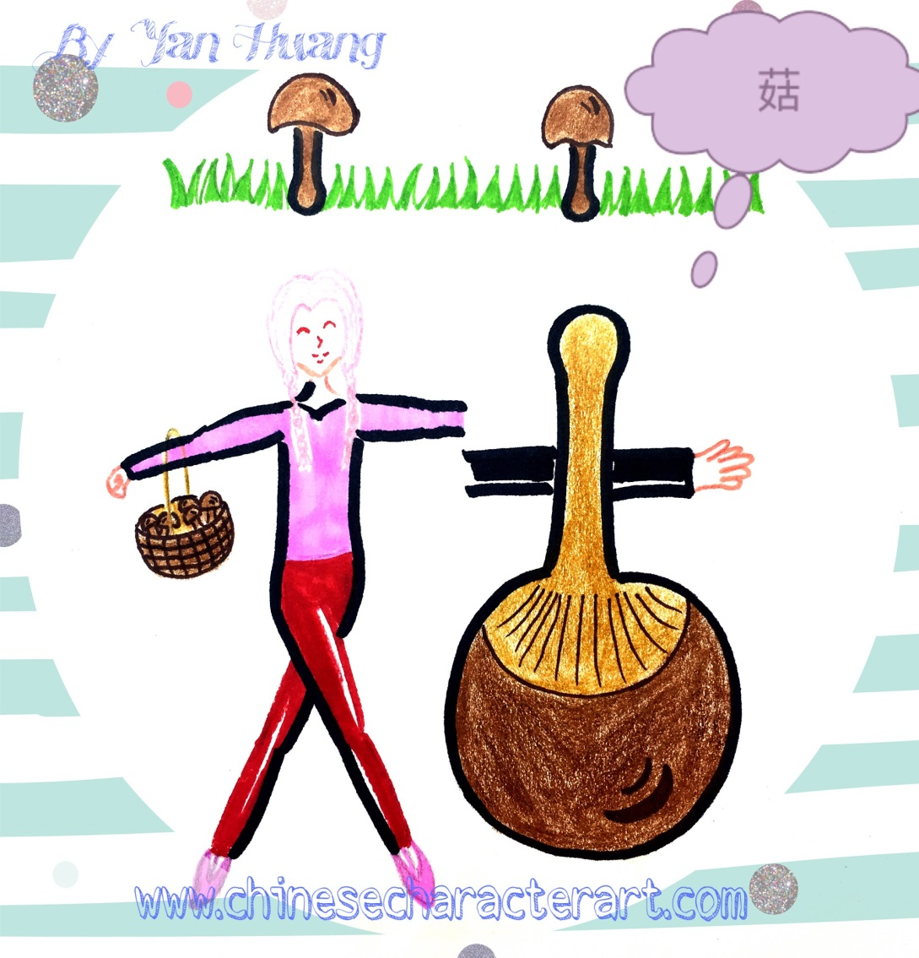
菇Gū
mushroom

Slide 6

吹Chuī
To blow

Slide 7
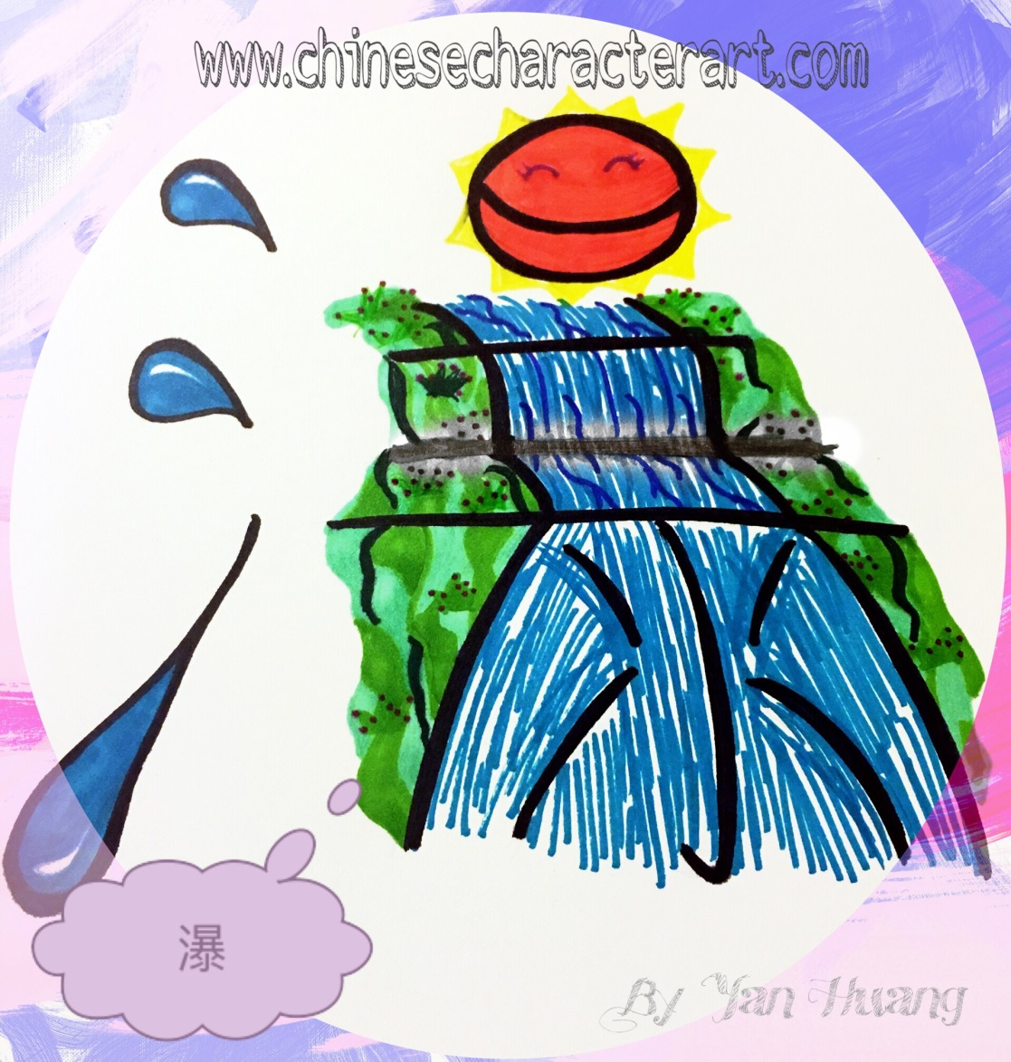
瀑Pù
waterfall

Slide 8

云Yún
cloud

Slide 9
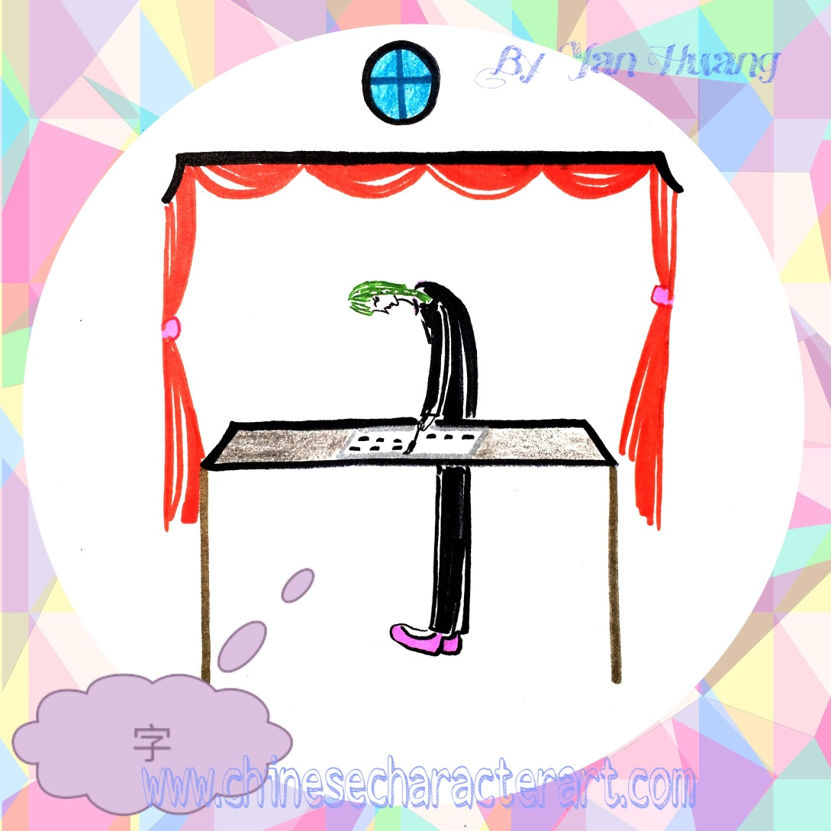
字Zì
Character;word

Slide 10
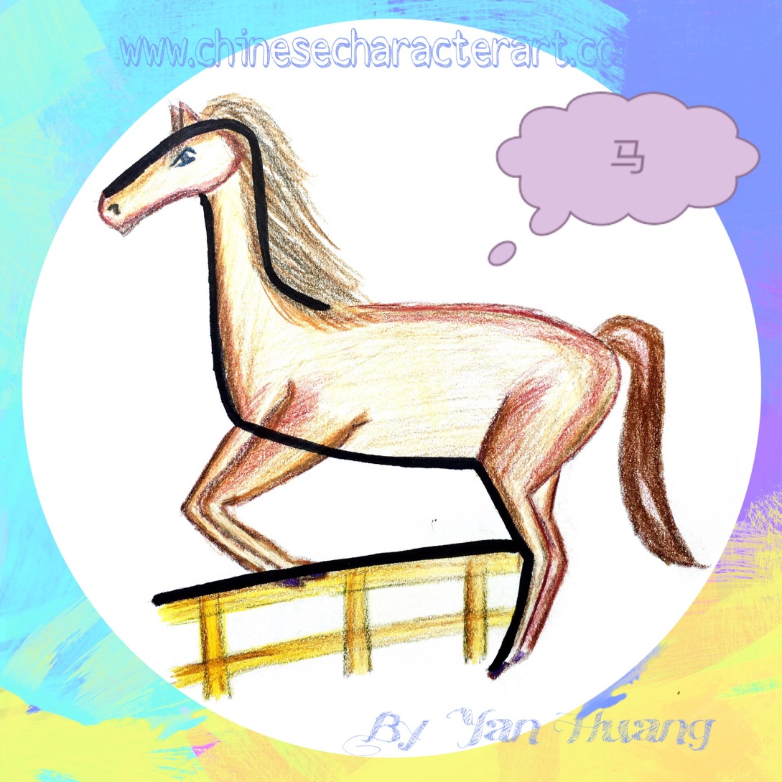
马Mǎ
horse

Slide 11

识Shì
To know;
To recognize

Slide 12

谢Xiè
To thank

Slide 13
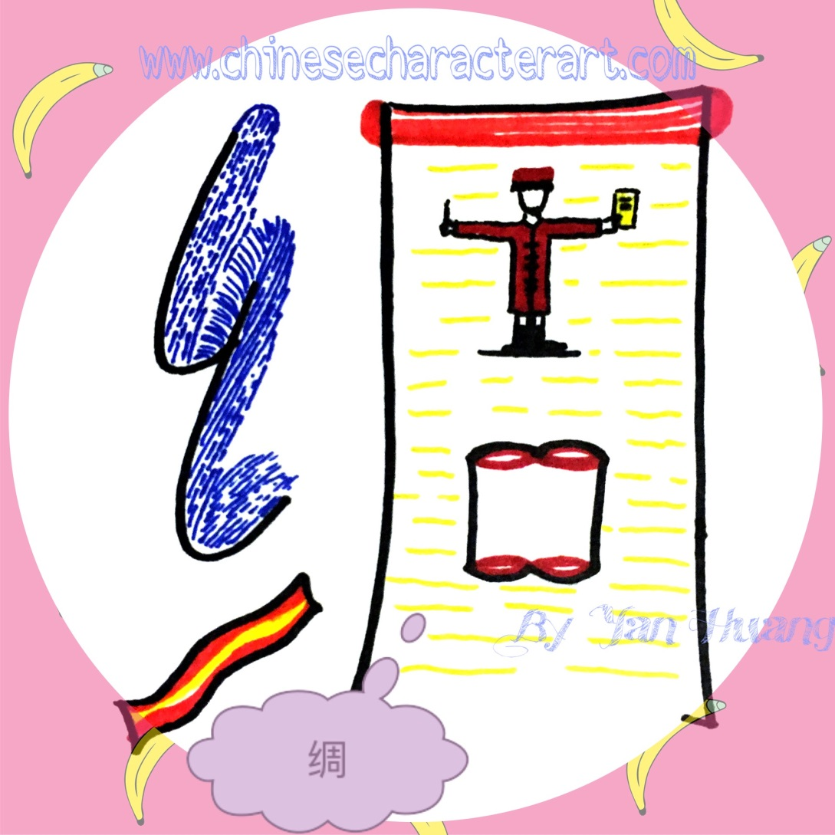
绸Chóu
silk

Slide 14
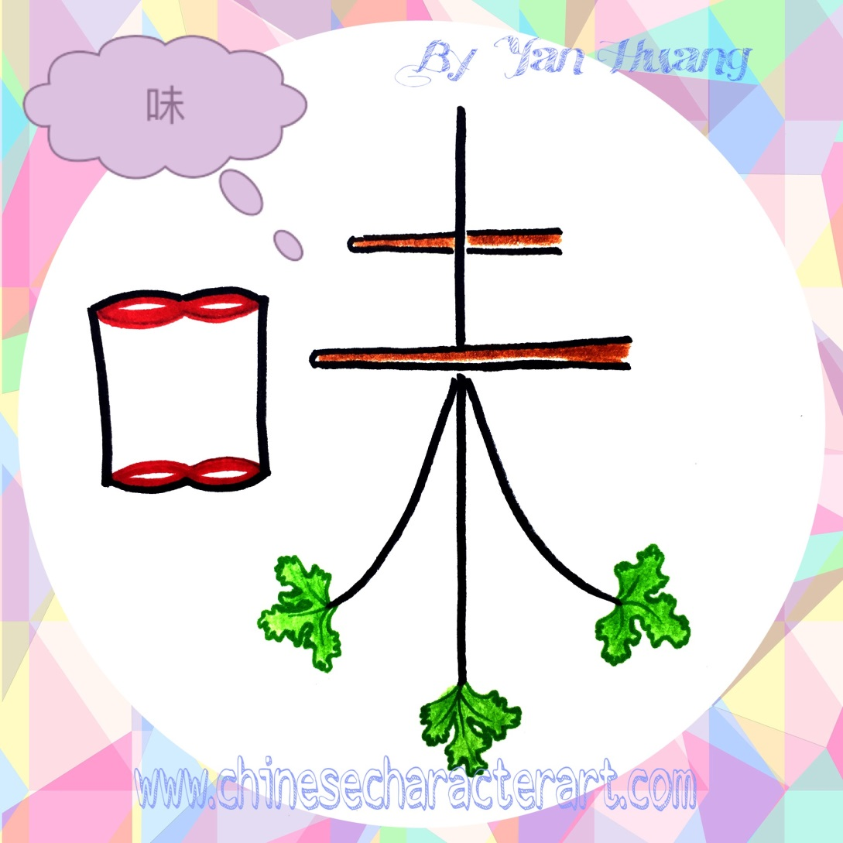
味Wèi
taste

Slide 15
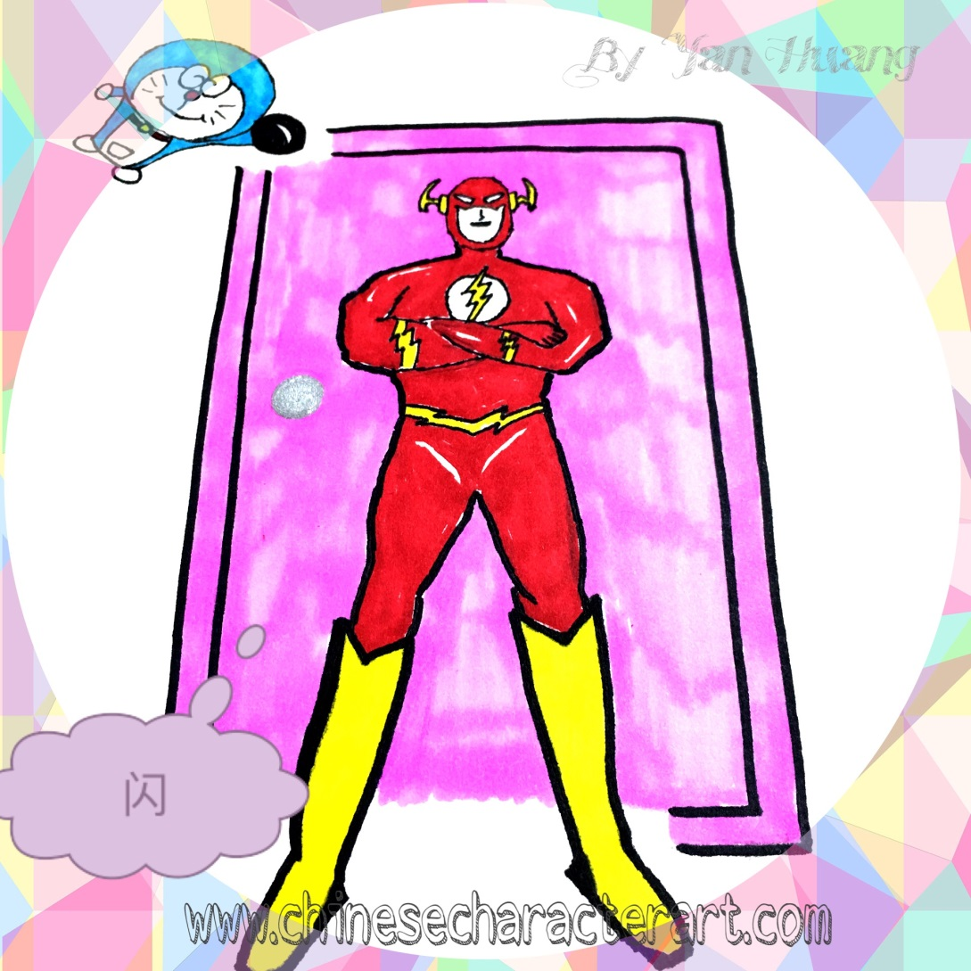
闪Shǎn
flash

Slide 16
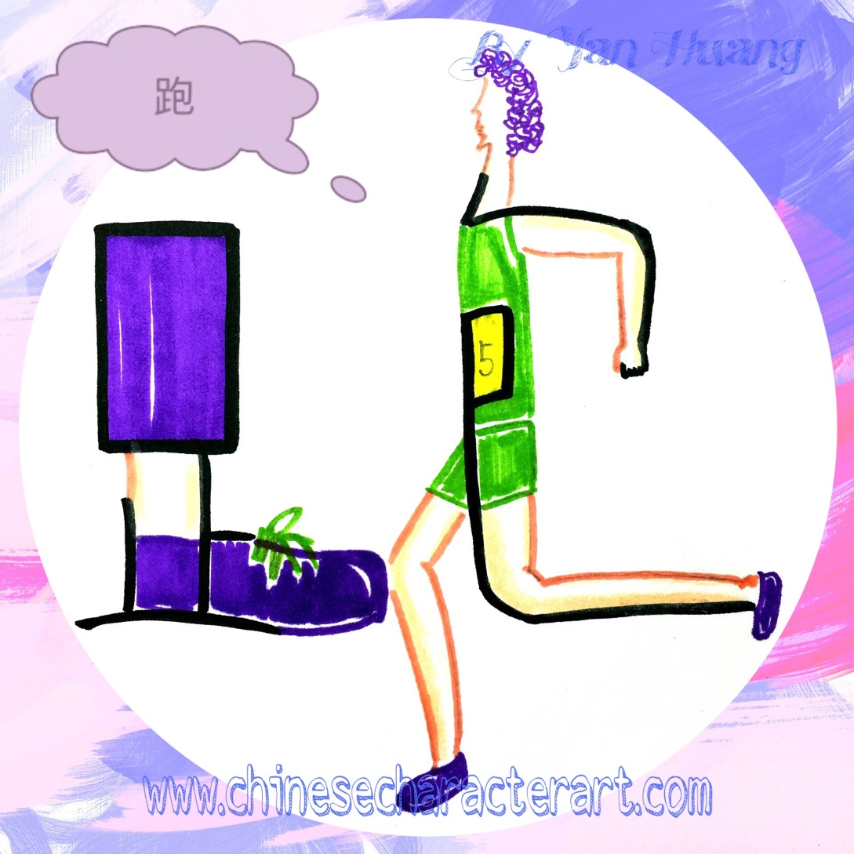
跑Pǎo
To run

Slide 17

书Shū
book

Slide 18
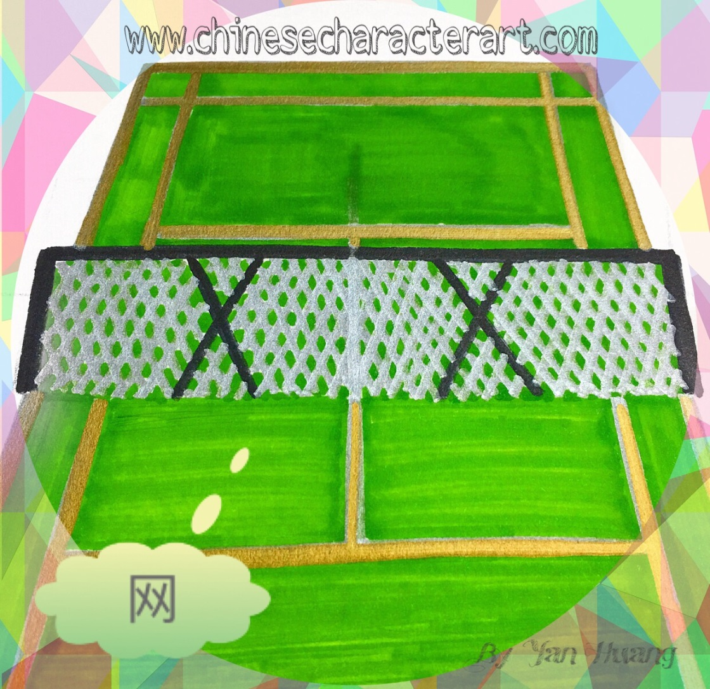
网Wǎng
net

Slide 19
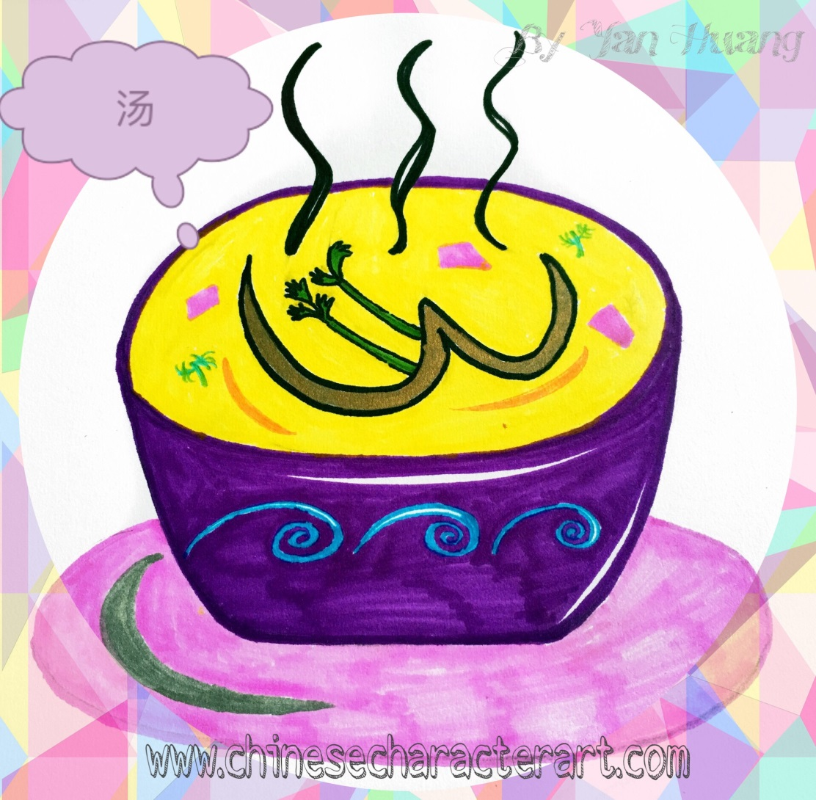
汤Tāng
soup

Slide 20
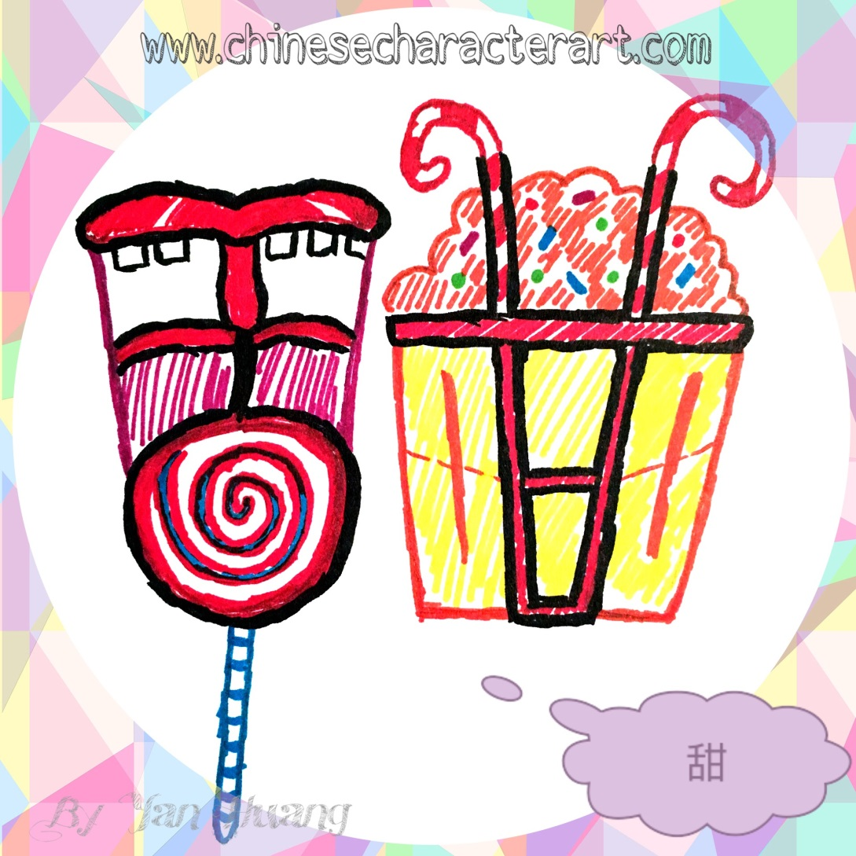
甜Tián
sweet

Slide 21
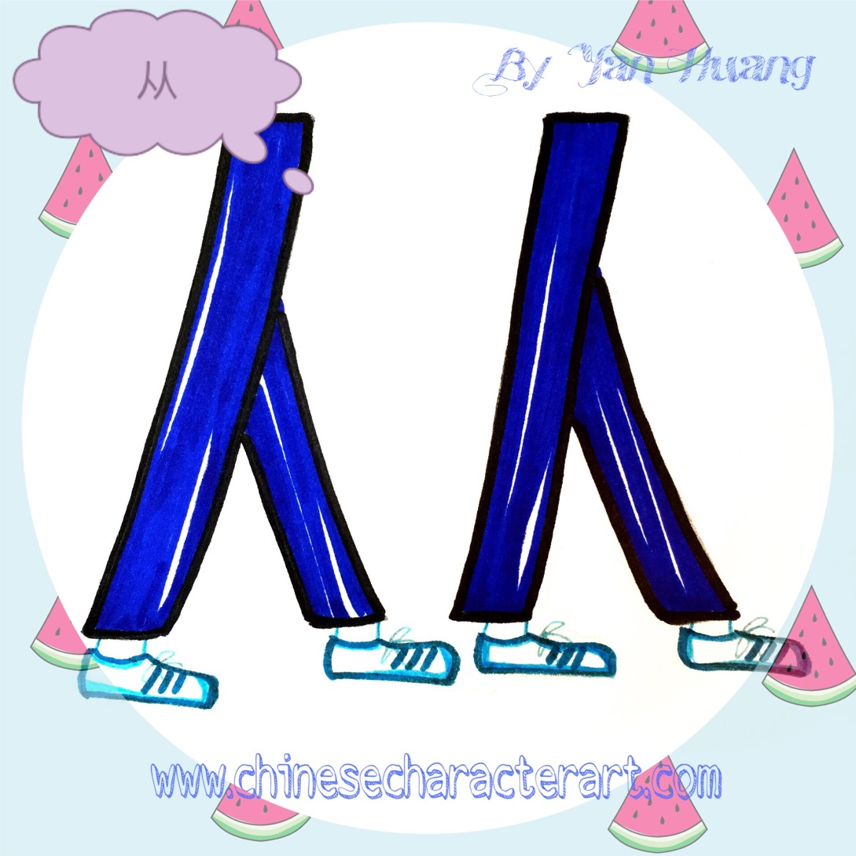
从Cóng
To follow;
from

Slide 22

丝Sī
silk

Slide 23
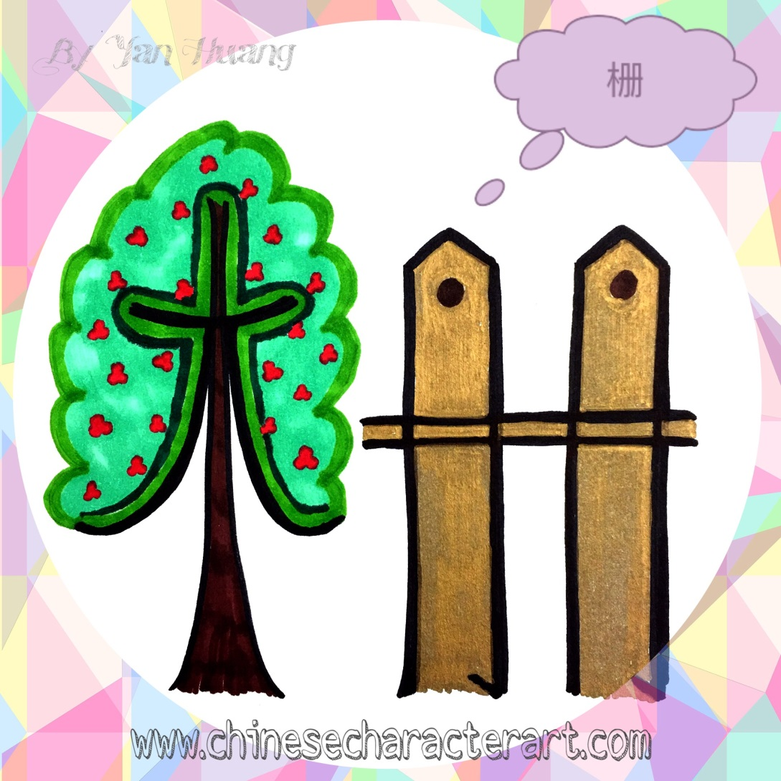
栅Zhà
fence

Slide 24

植Zhí
plant

Slide 25
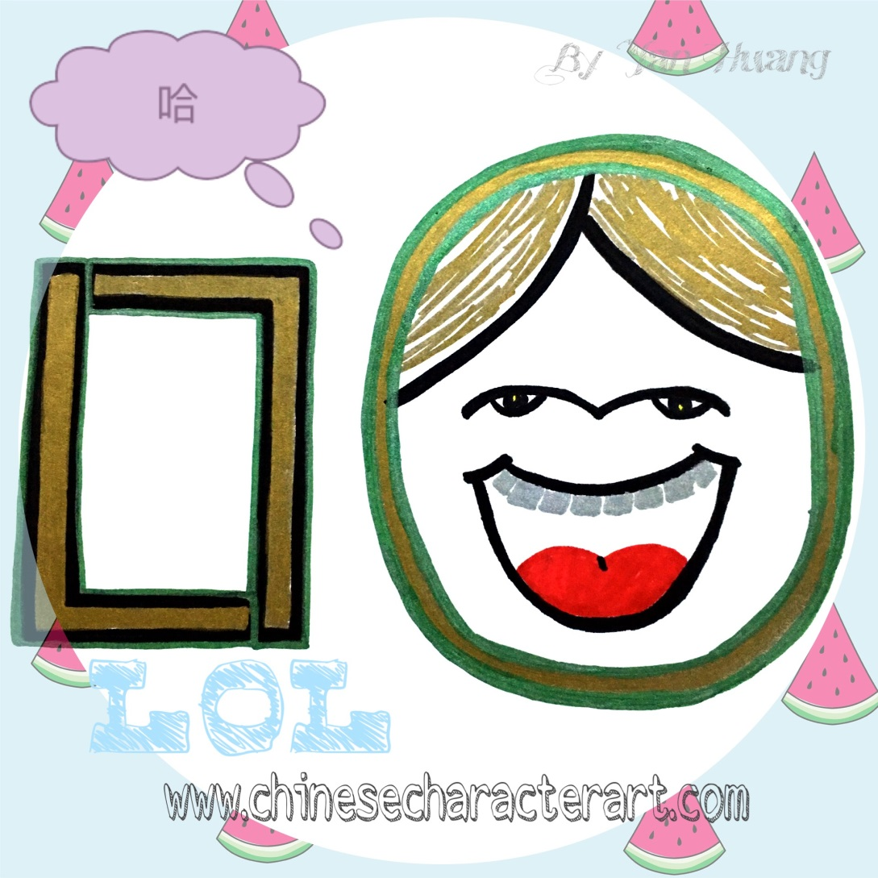
哈Hā
laughing

Slide 26
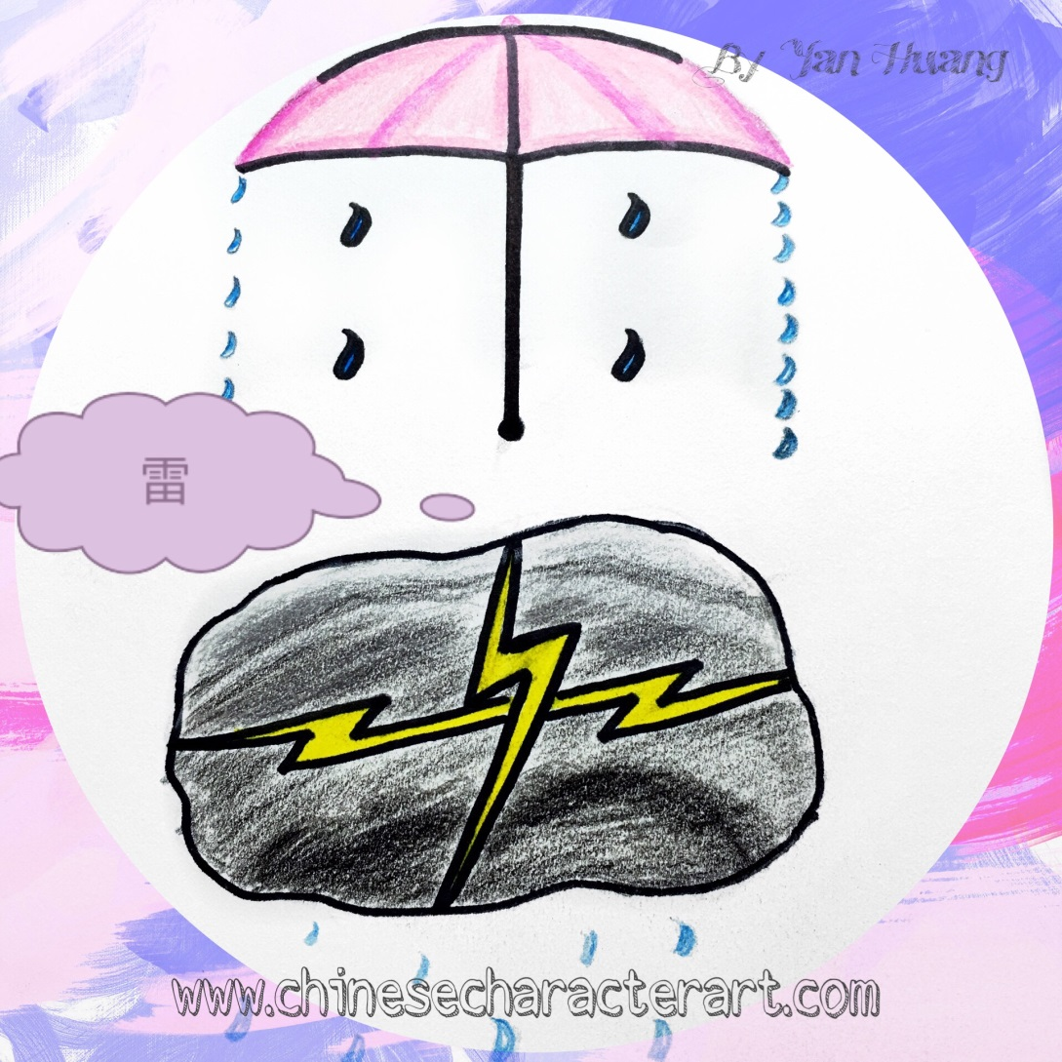
雷Léi
thunder

Slide 27

风Fēng
wind

Slide 28
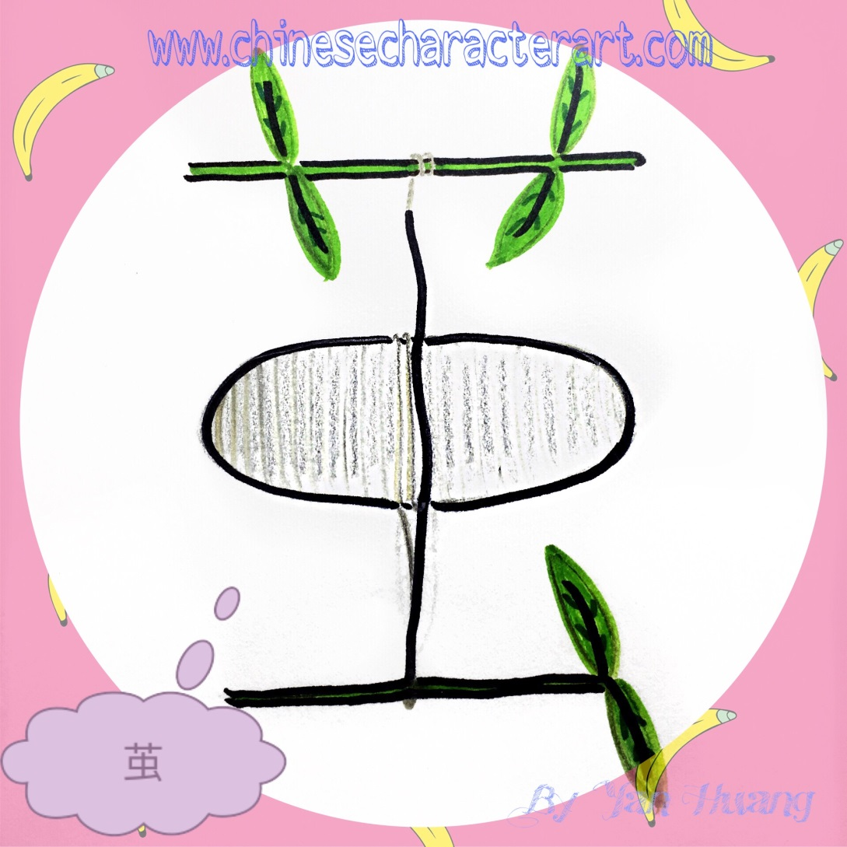
茧Jiǎn
cocoon

Slide 29
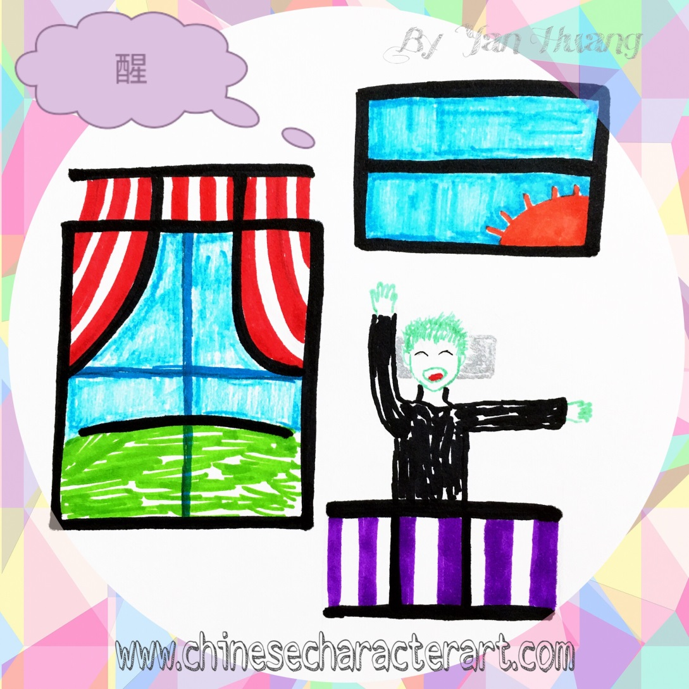
醒Xǐng
To wake up

Slide 30
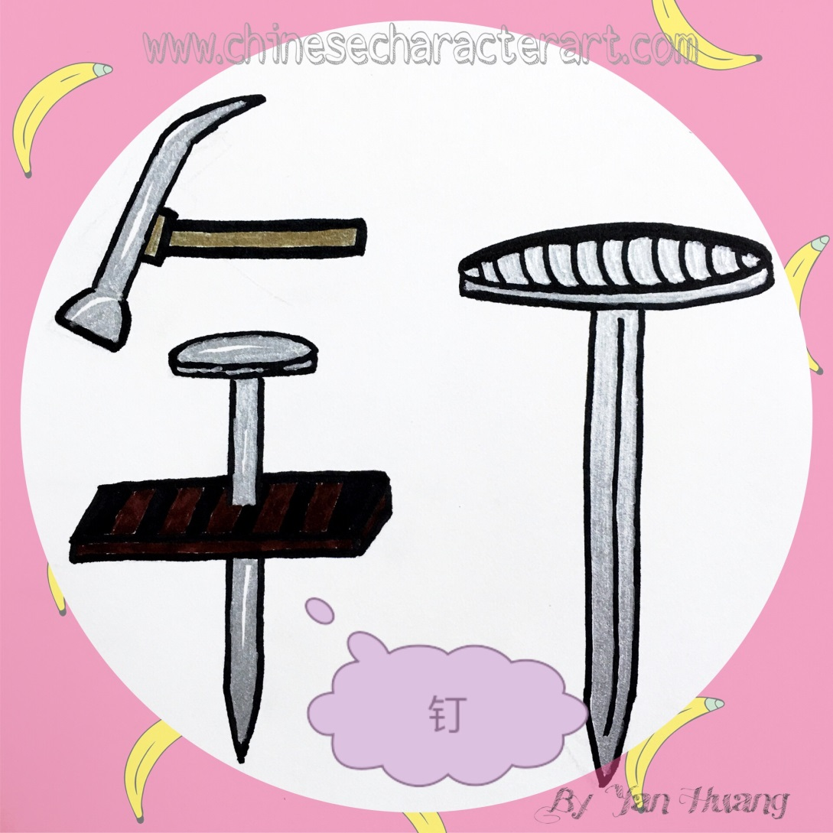
钉Dīng
nail

Slide 31

它Tā
it

Slide 32

伞Sǎn
umbrella

Slide 33
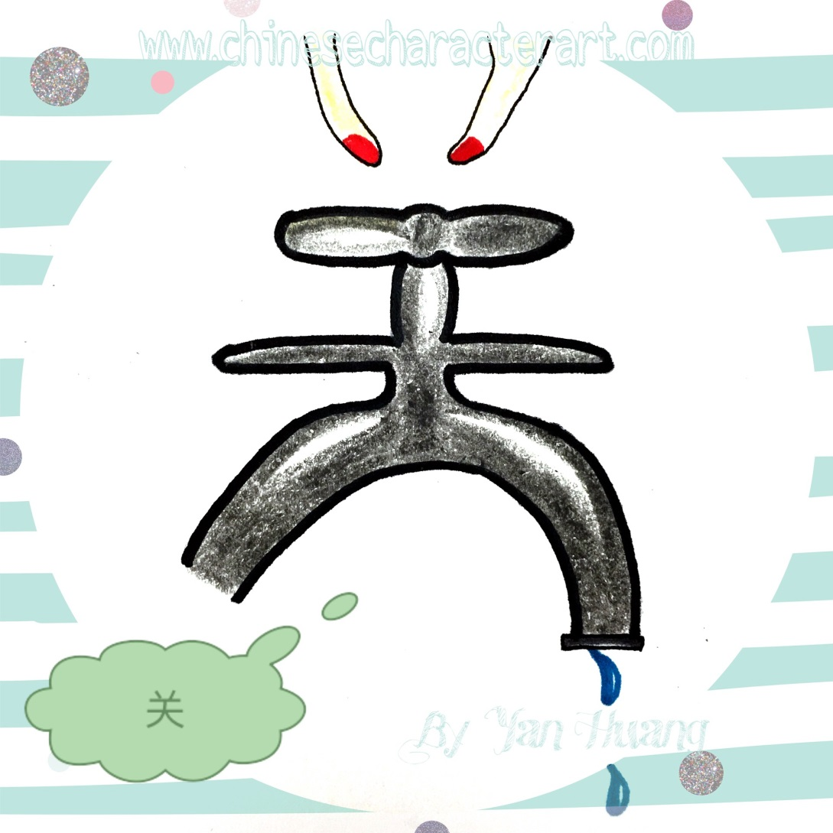
关Guān
To close; to turn off

Slide 34

温Wēn
warm

Slide 35
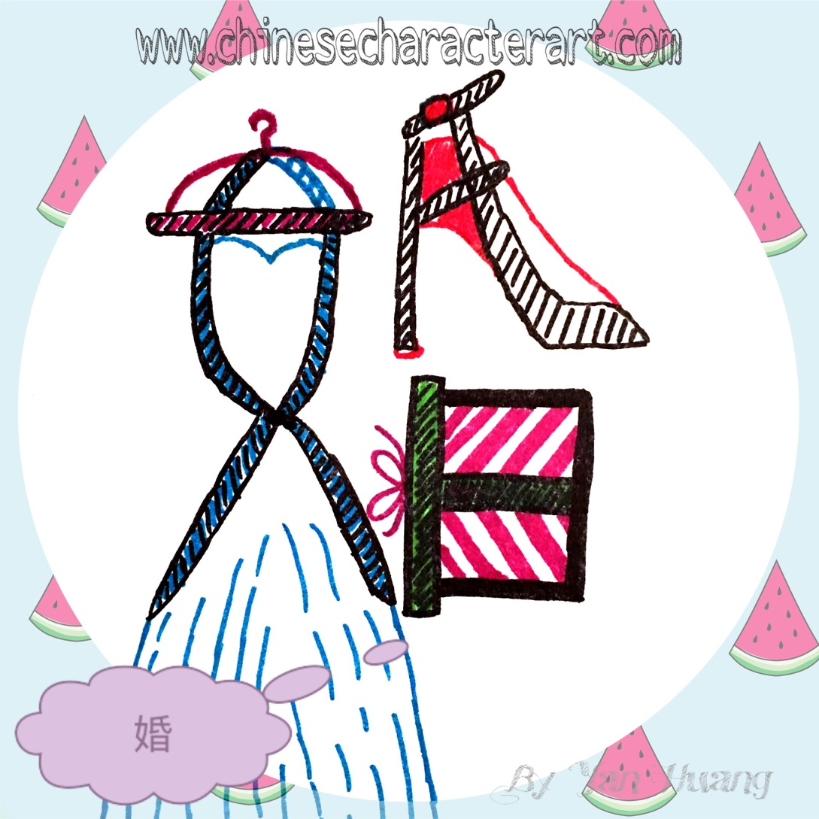
婚Hūn
To marry

Slide 36
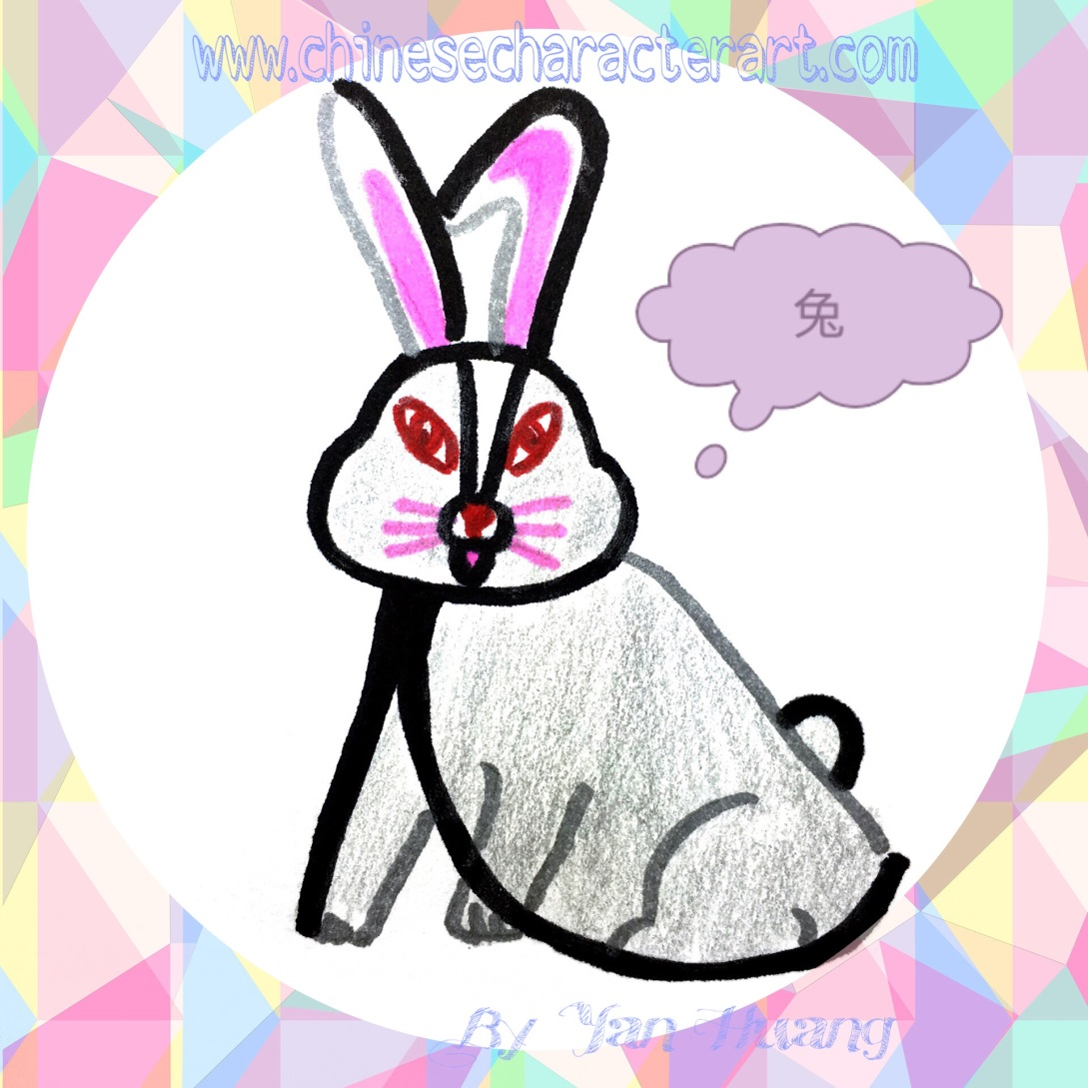
兔Tù
rabbit

Slide 37

思Sī
To think

Slide 38
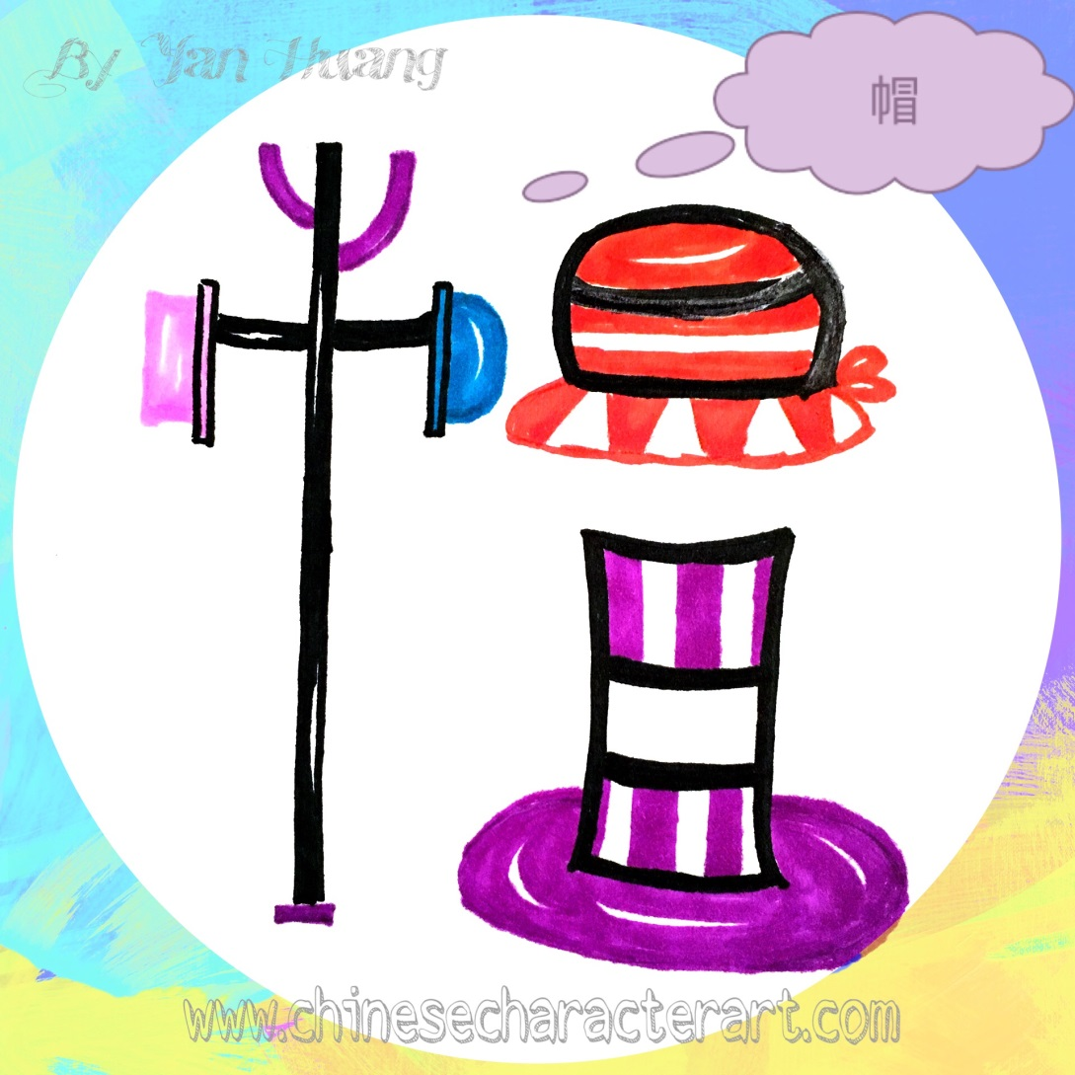
帽Mào
hat

Slide 39
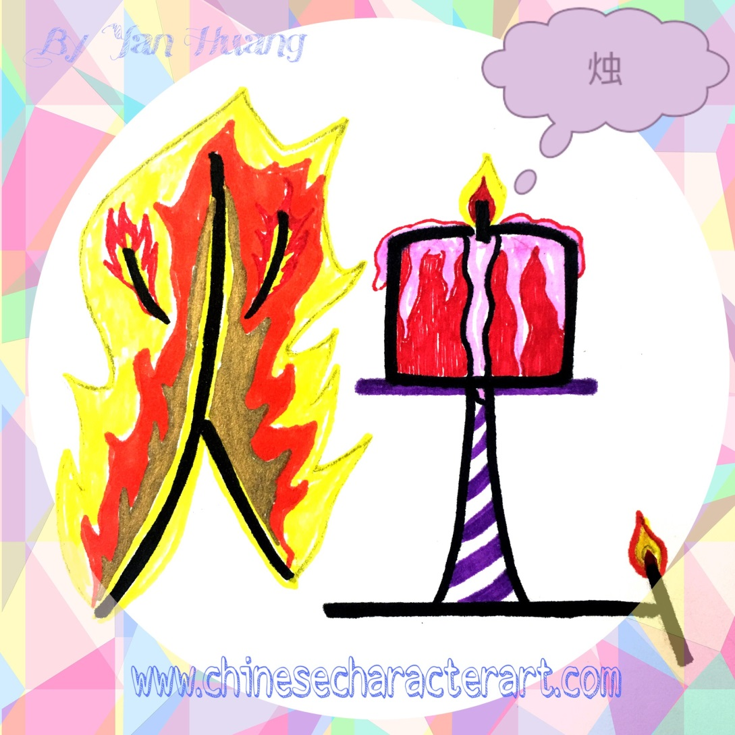
烛Zhú
candle

Slide 40
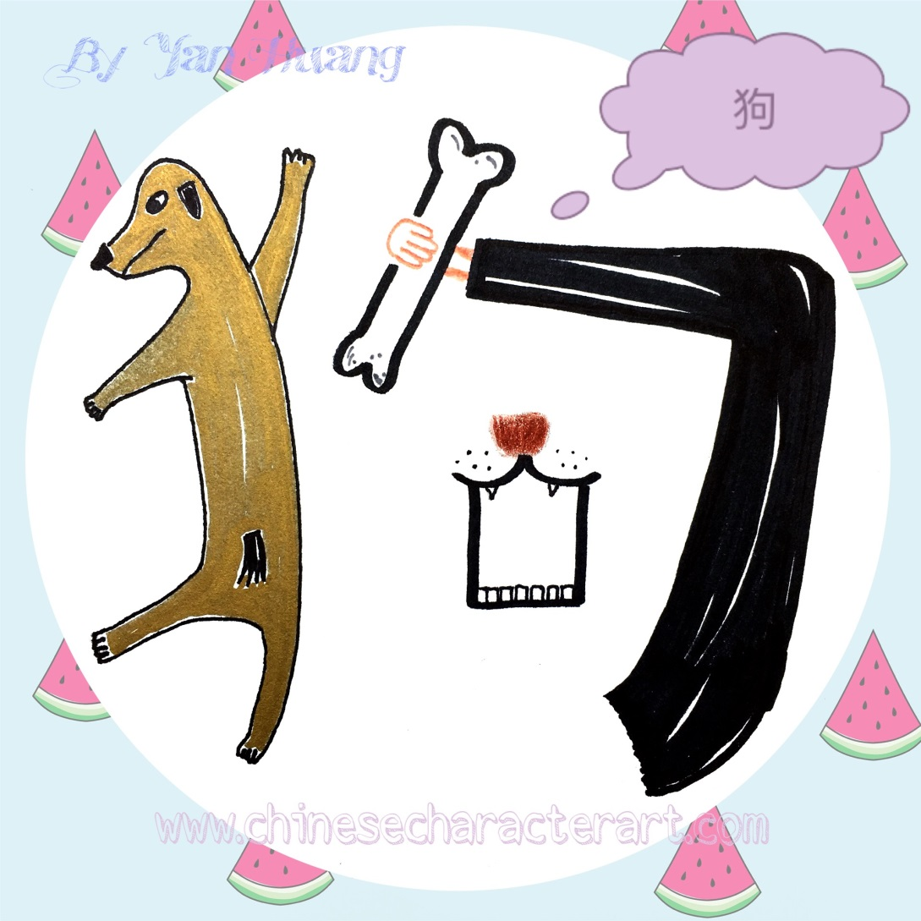
狗Gǒu
dog

Slide 41
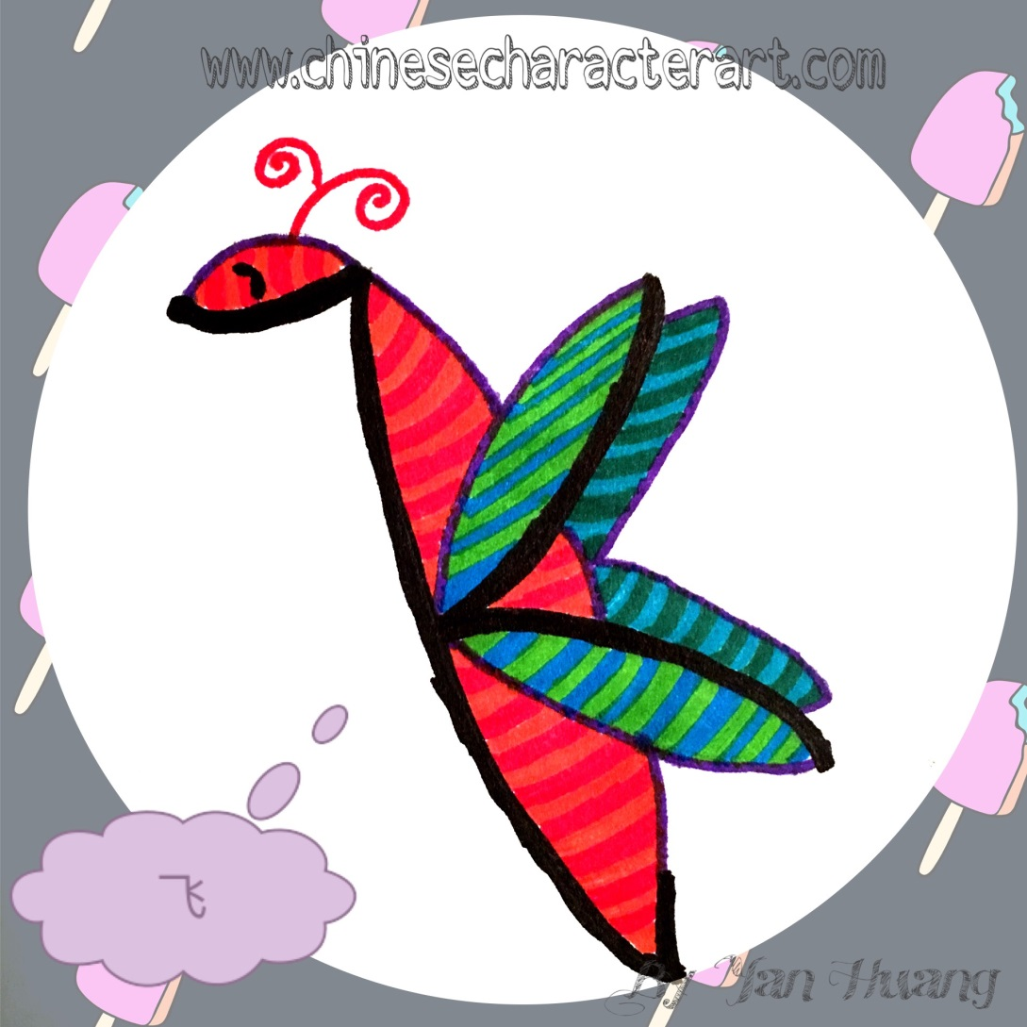
飞Fēi
To fly

Slide 42

沙Shā
sand

Slide 43
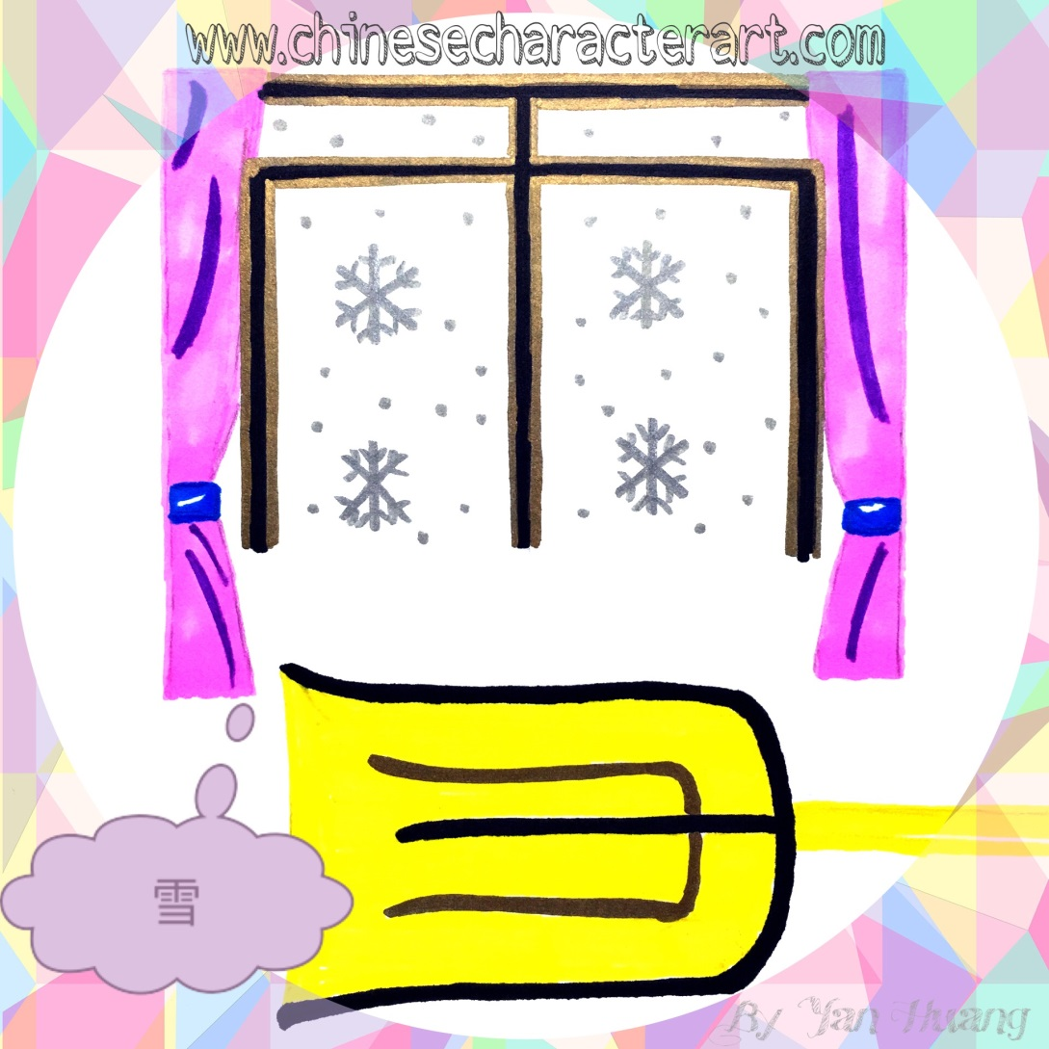
雪Xuě
snow

Slide 44
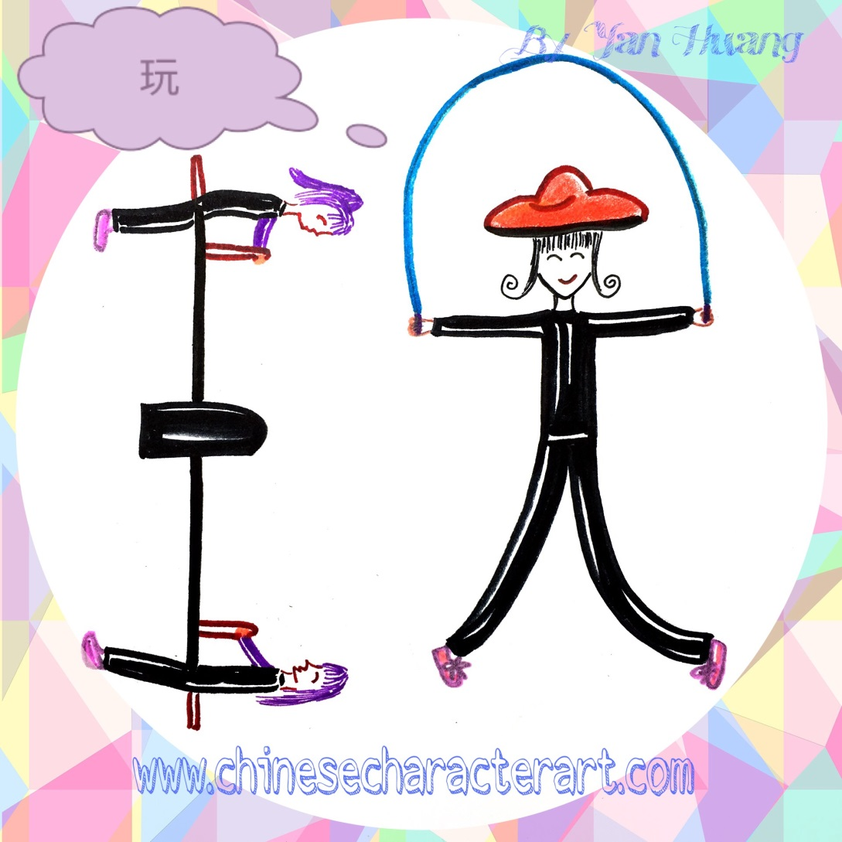
玩Wán
To play;
to have fun

Slide 45

海Hǎi
sea, ocean

Slide 46

敌Dí
enemy

Slide 47

泪Lèi
tear

Slide 48

评Píng
To comment

Slide 49
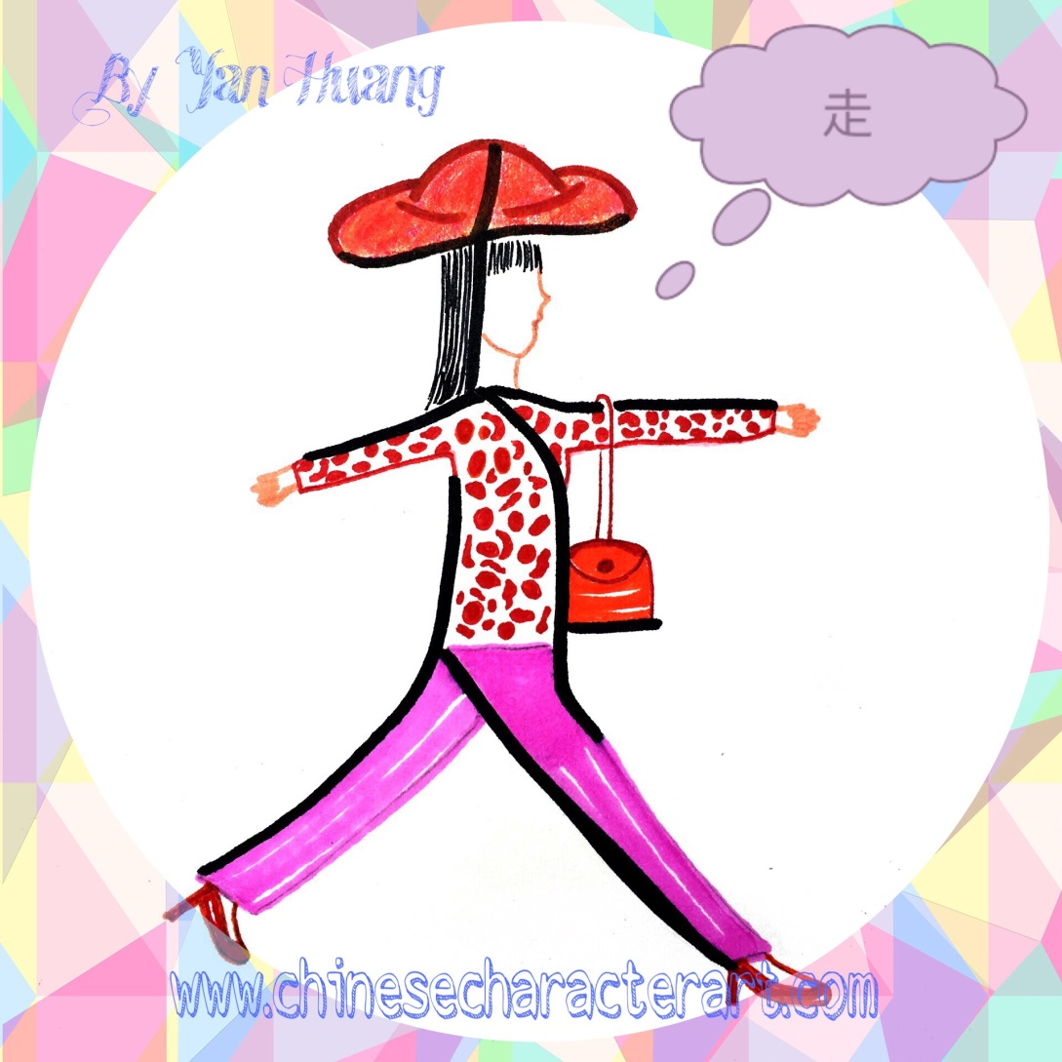
走Zǒu
To walk

Slide 50

身Shēn
body

Slide 51
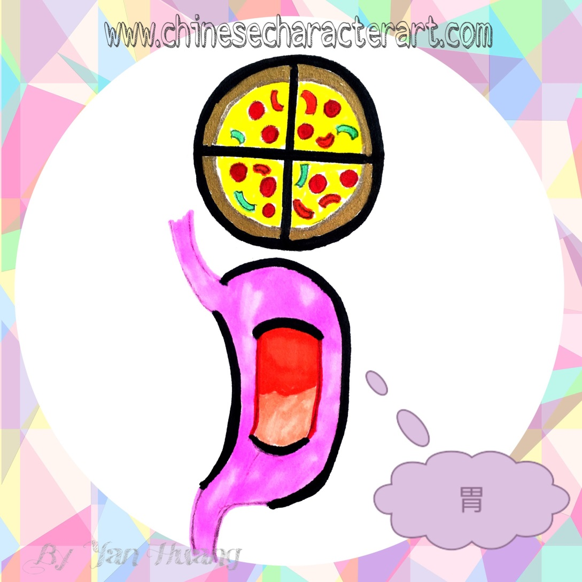
胃Wèi
stomach

Slide 52
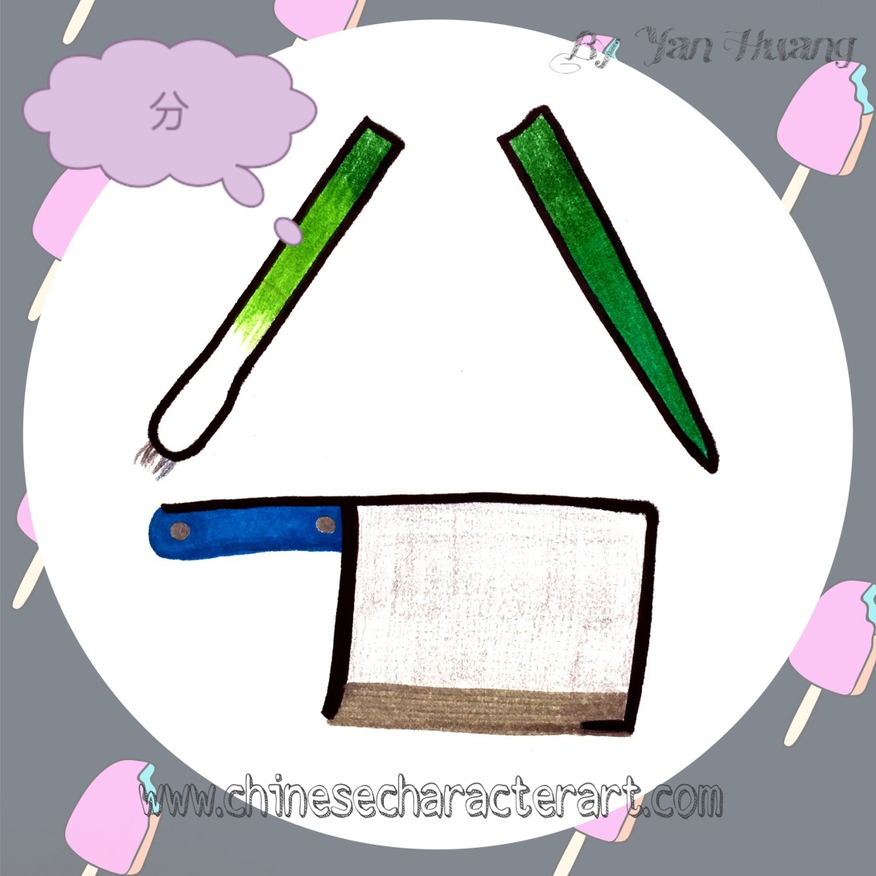
分Fēn
To divide;
to separate

Slide 53
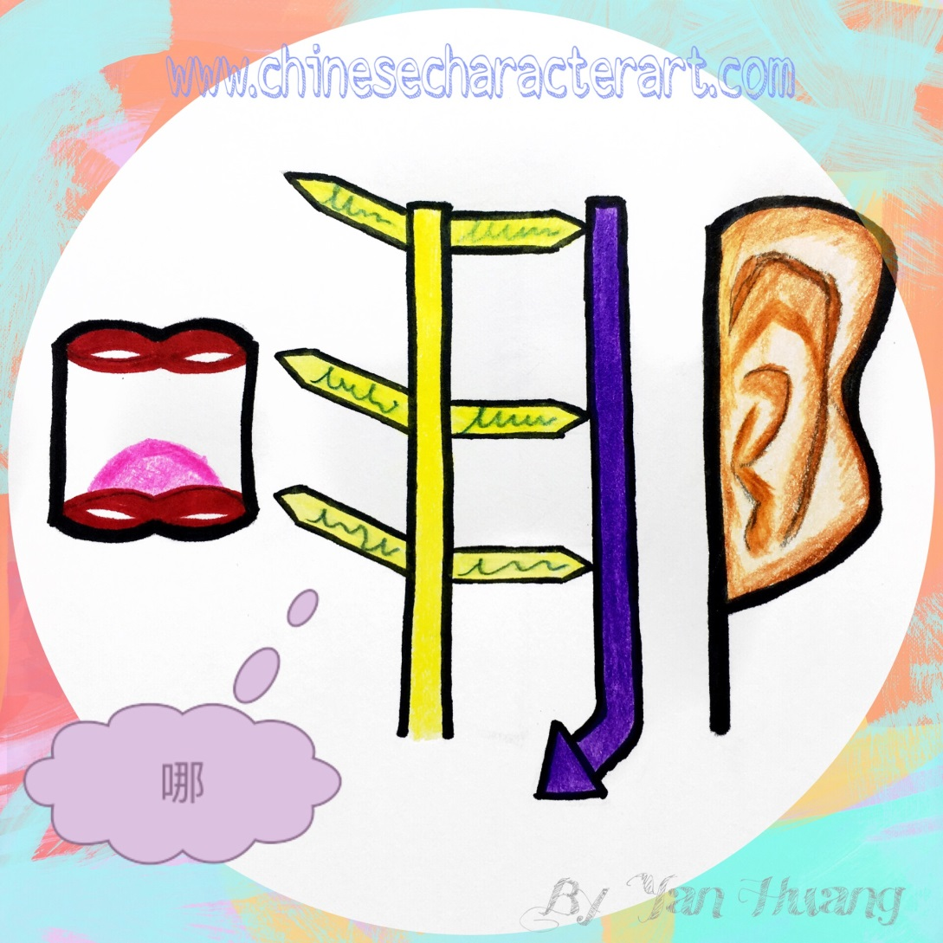
哪Nǎ
where

Slide 54
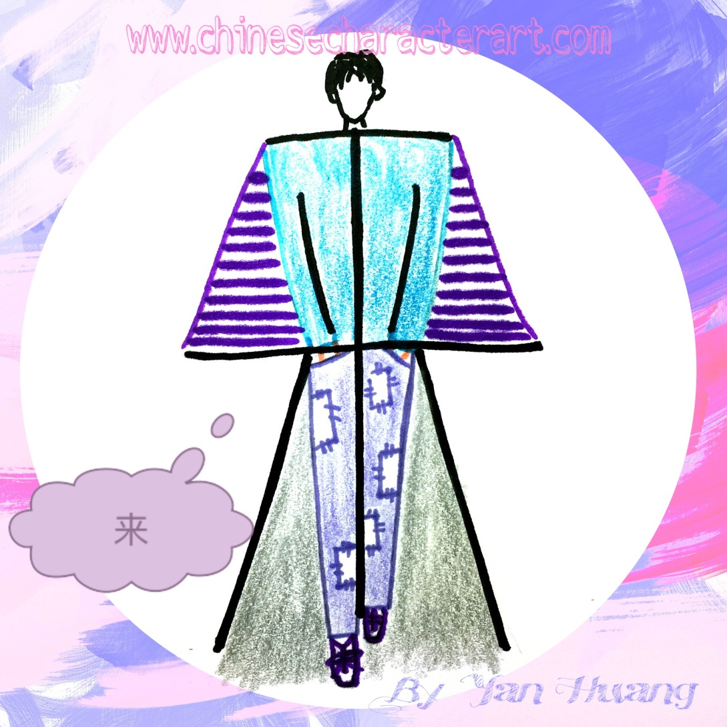
来Lái
To come

Slide 55
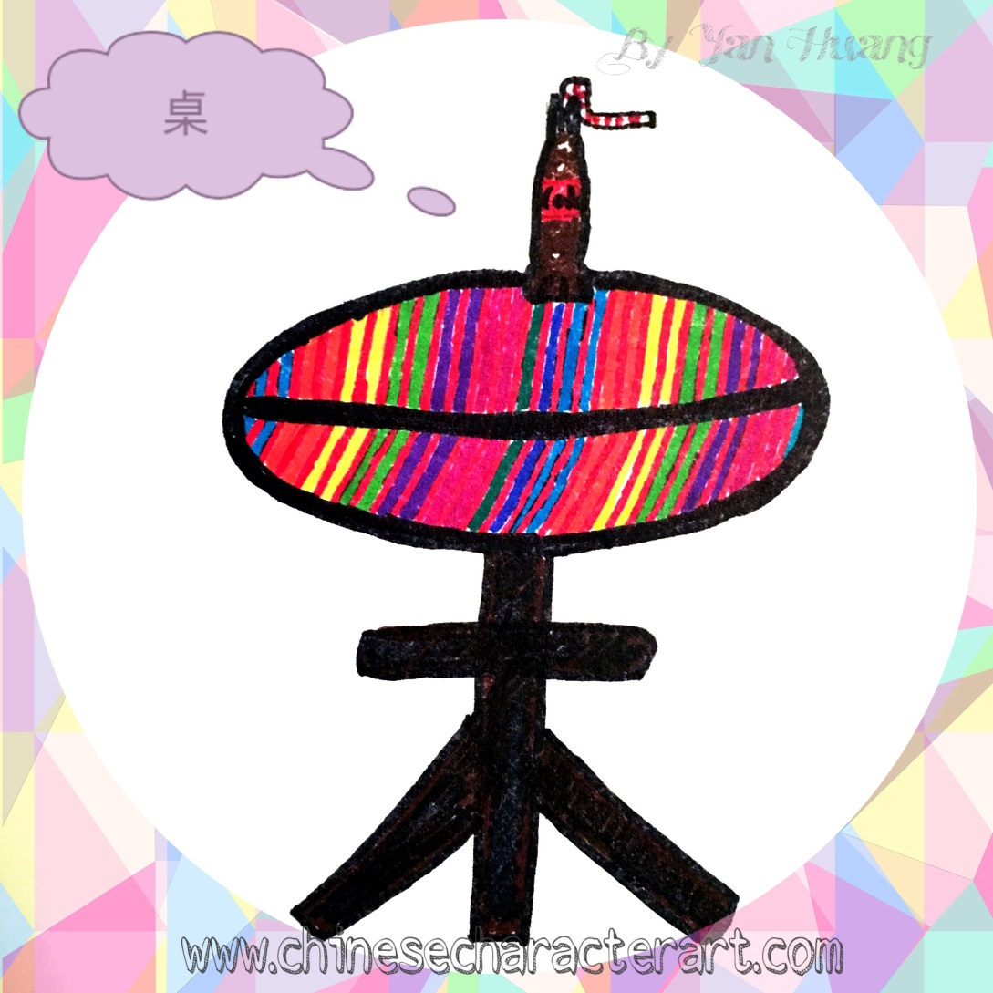
桌Zhuō
Desk; table

Slide 56
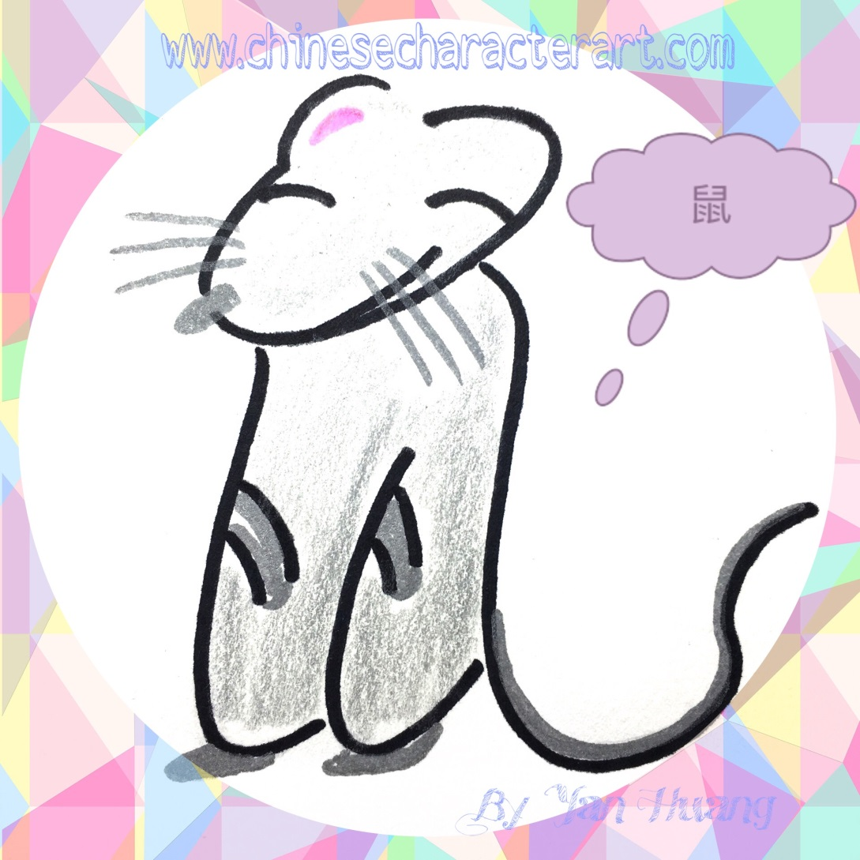
鼠Shǔ
mouse

Slide 57

船Chuán
boat

Slide 58
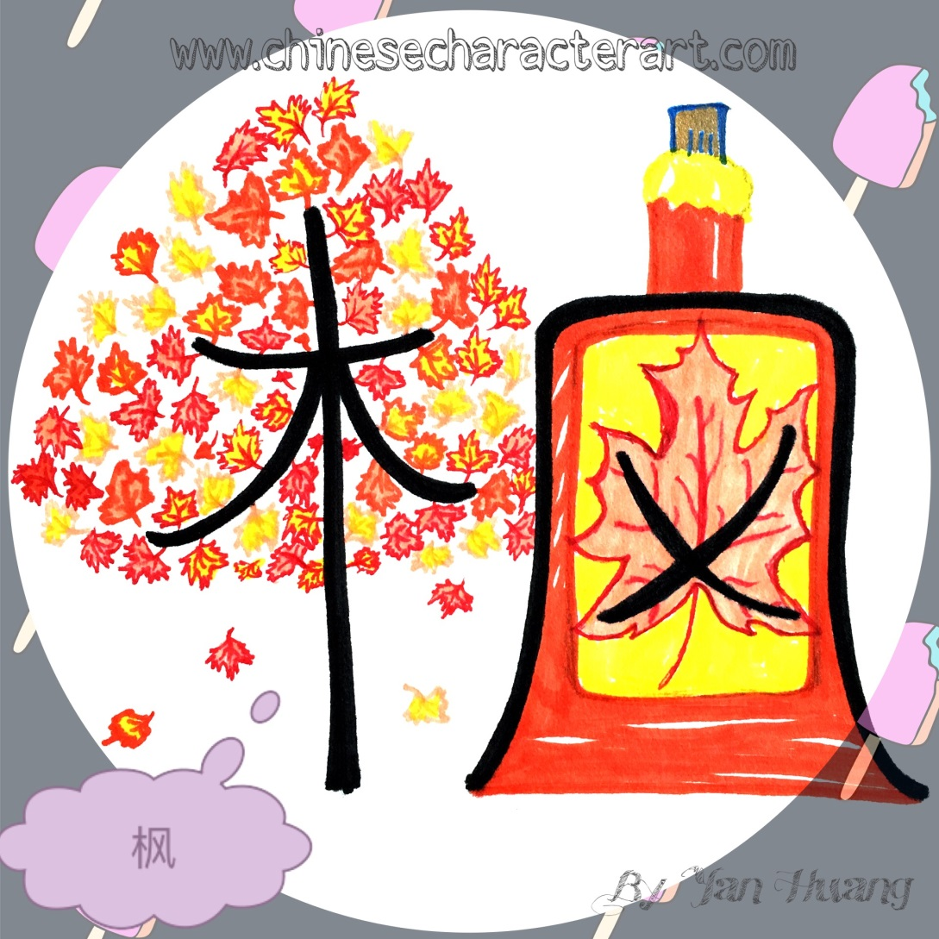
枫Fēng
maple

Slide 59
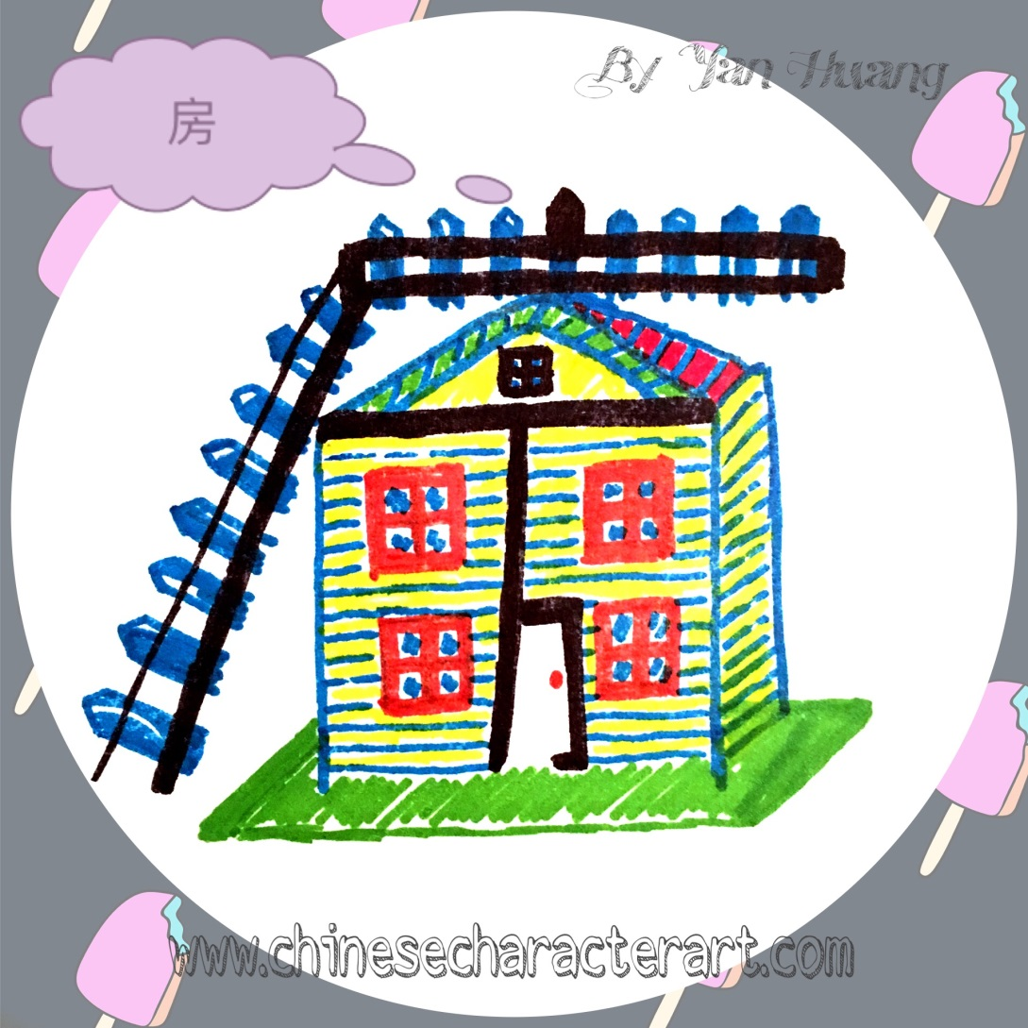
房Fáng
house

Slide 60
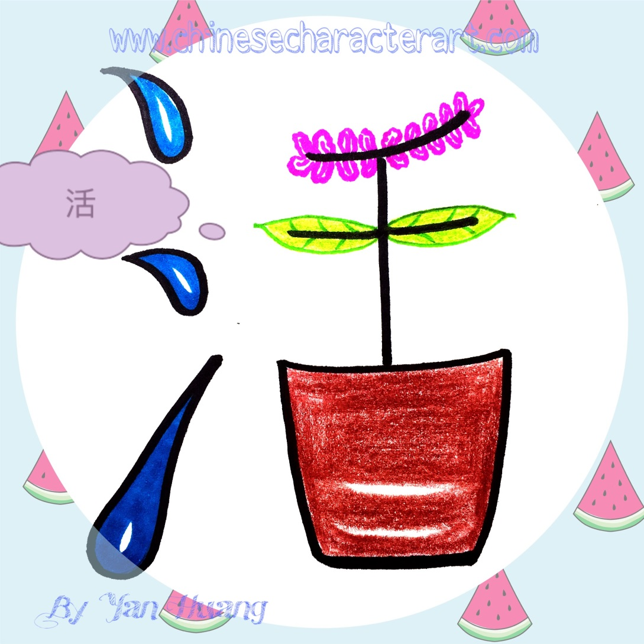
活Huó
To live

Slide 61
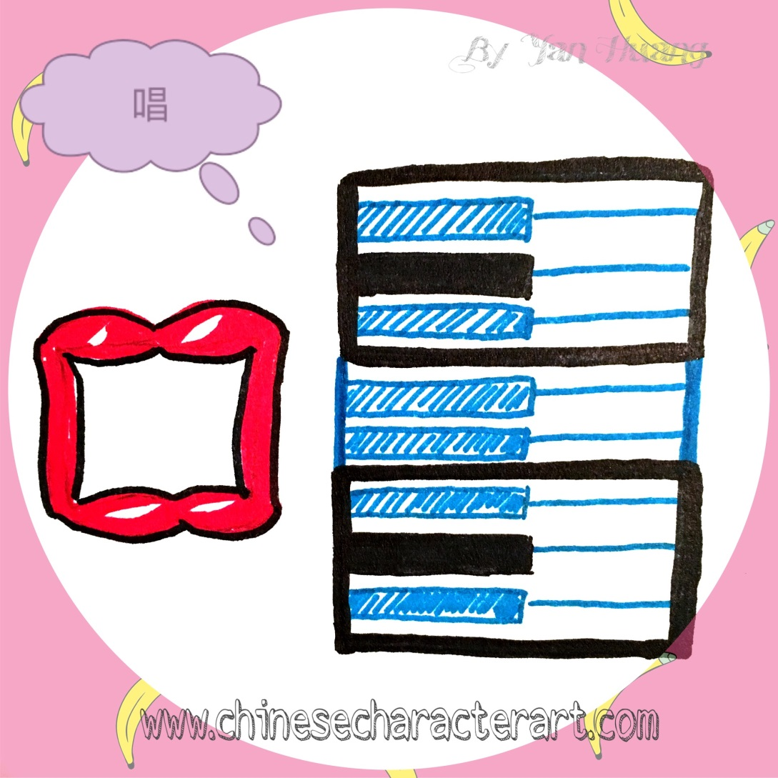
唱Chàng
To sing

Slide 62
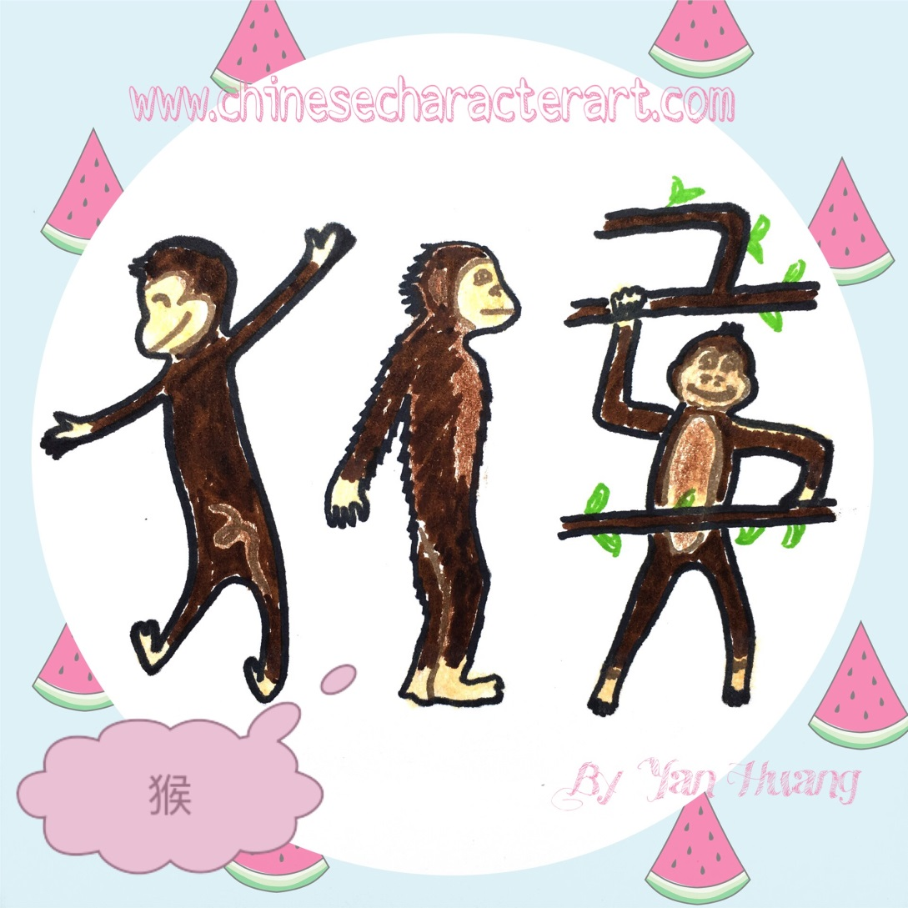
猴Hóu
monkey

Slide 63

夜Yè
evening

Slide 64
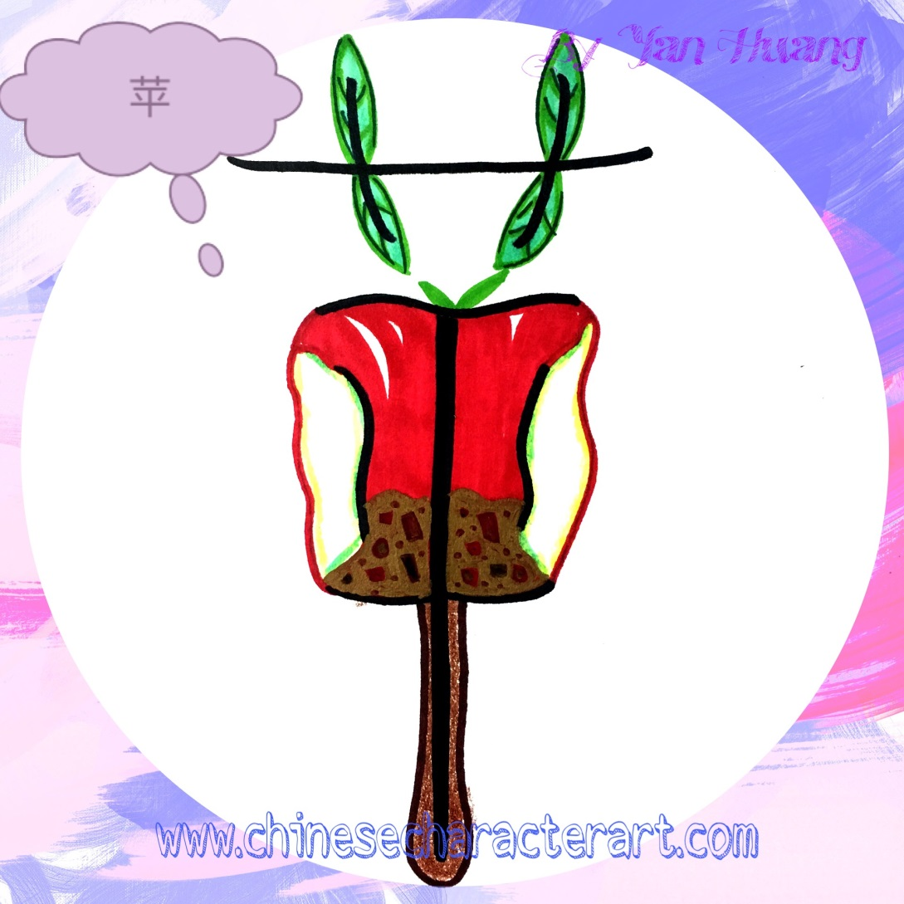
苹Píng
apple

Slide 65

蛇Shé
snake

Slide 66

快Kuài
Fast;
quick

Slide 67
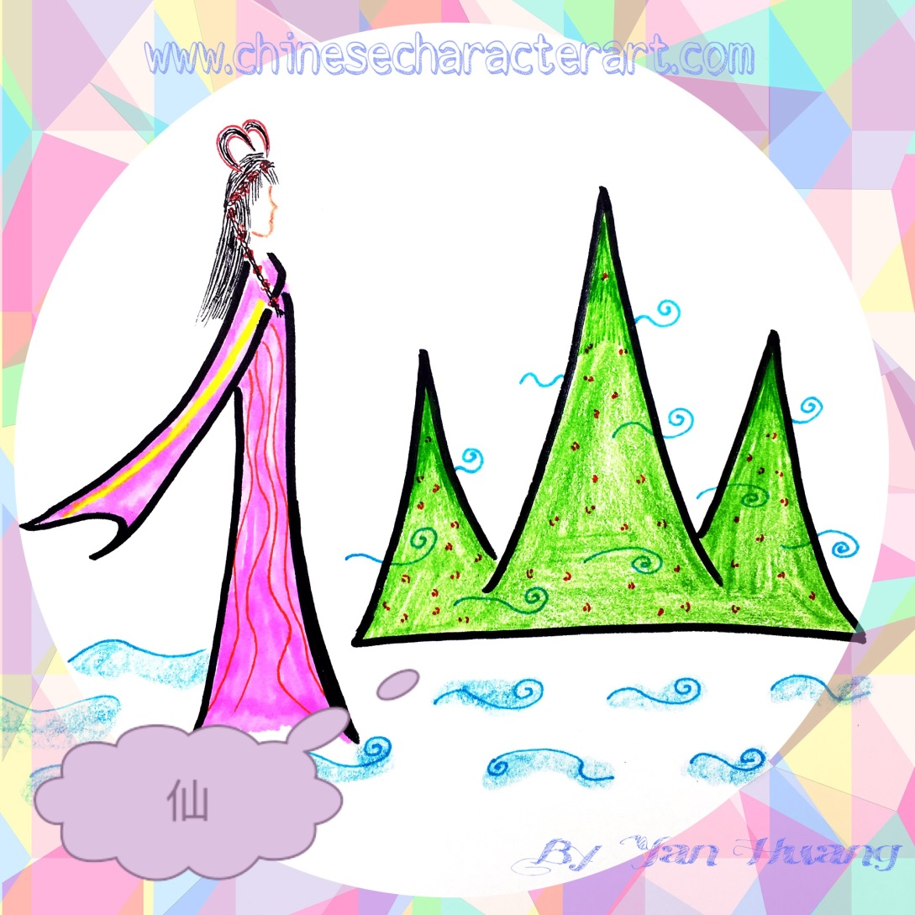
仙Xiān
fairy

Slide 68

明Míng
bright

Slide 69
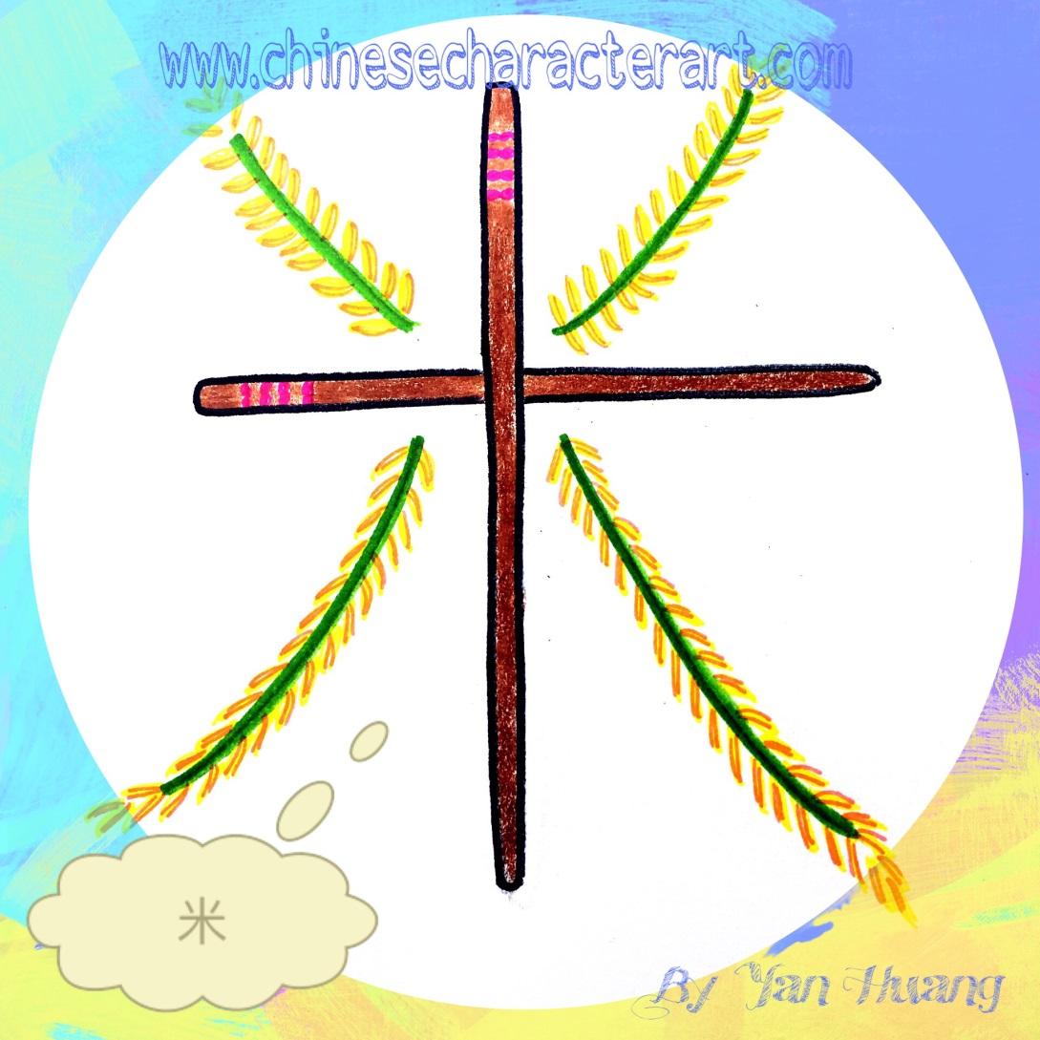
米Mǐ
rice

Slide 70

直Zhí
straight

Slide 71
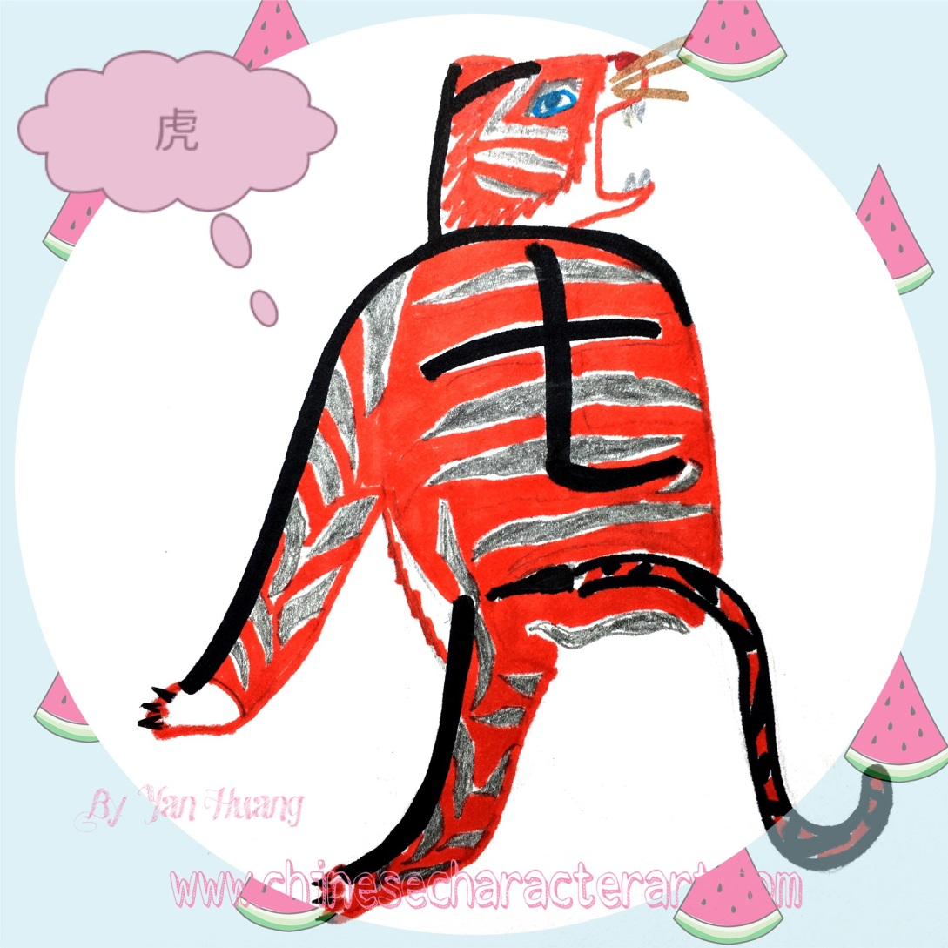
虎Hǔ
tiger

Slide 72
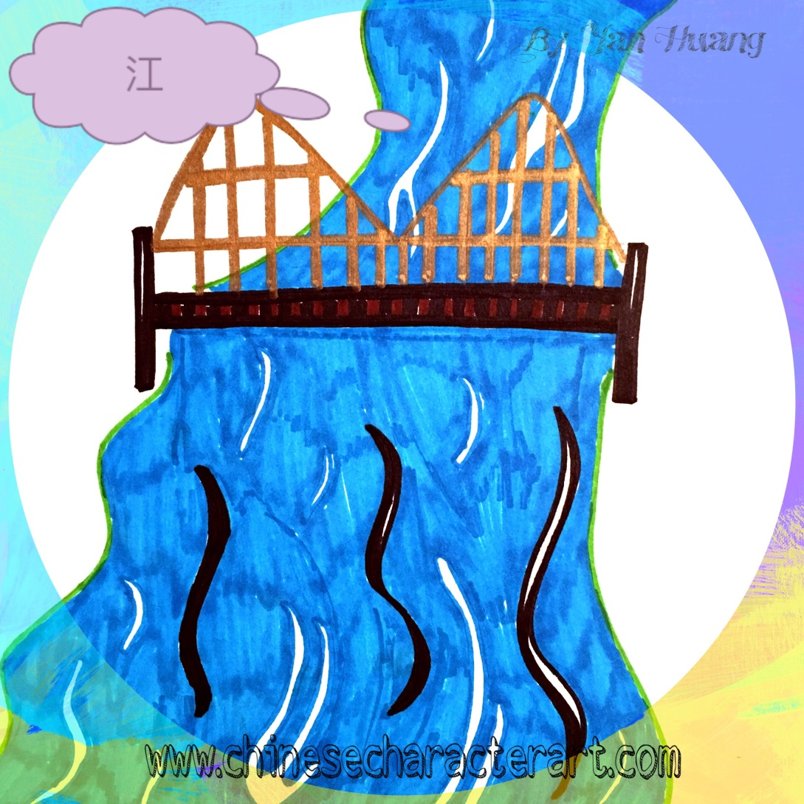
江Jiāng
river

Slide 73
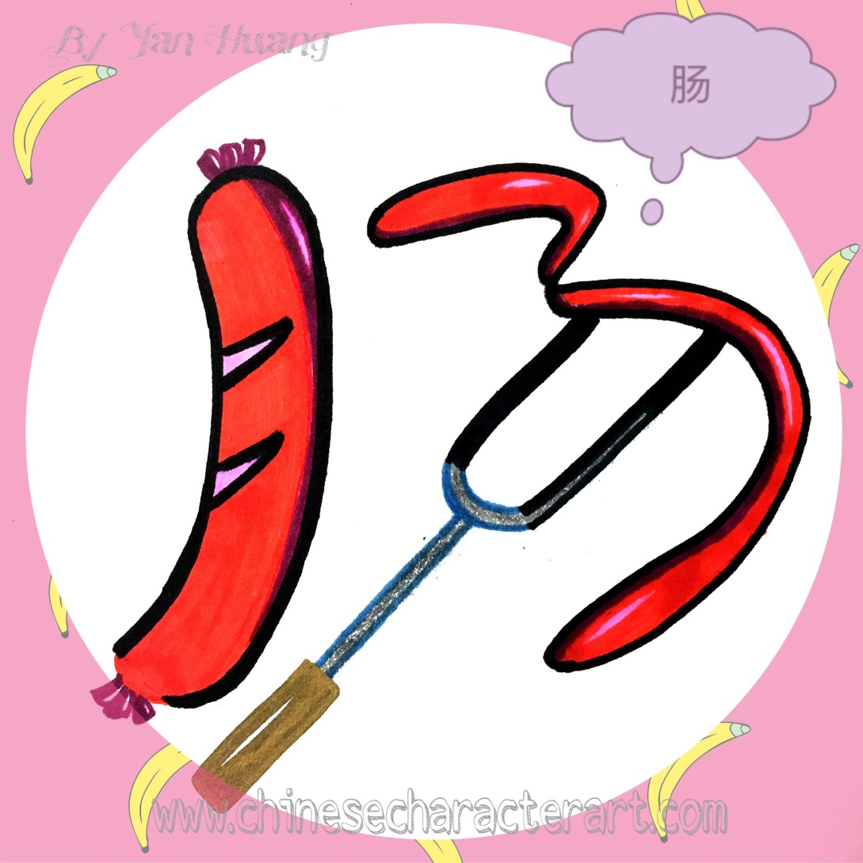
肠Cháng
Sausage;intestine

Slide 74
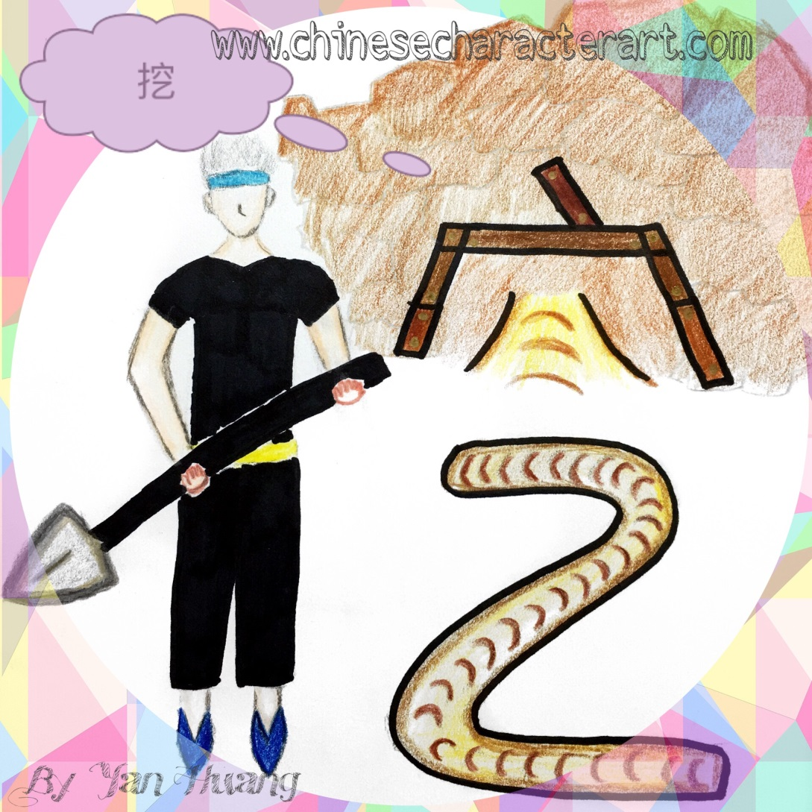
挖Wā
To dig

Slide 75

叹Tàn
sigh

Slide 76
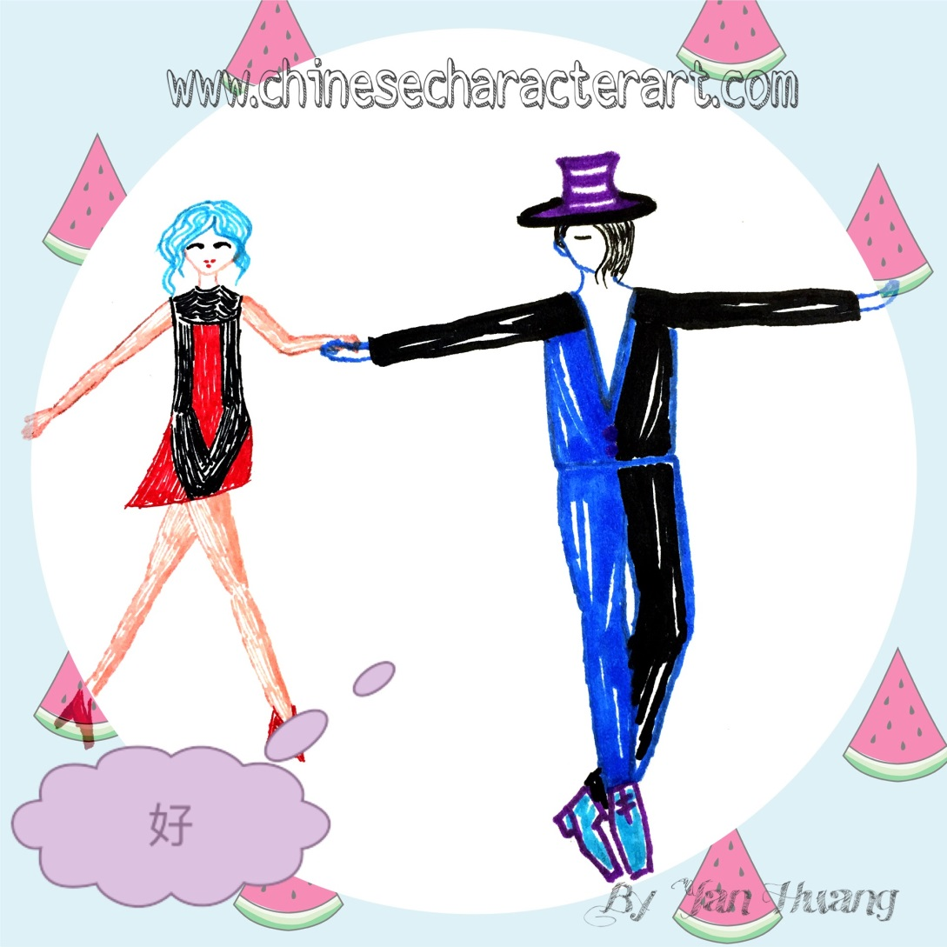
好Hǎo
good

Slide 77

吃Chī
To eat

Slide 78

迟Chí
late

Slide 79

春Chūn
spring

Slide 80

羊Yáng
sheep

Slide 81

歌Gē
song

Slide 82

给Gěi
To give

Slide 83

战Zhàn
Battle; war

Slide 84

河Hé
river

Slide 85

油Yóu
oil

Slide 86

住Zhù
To live;
To reside

Slide 87

吵Chǎo
noisy

Slide 88

猪Zhū
pig

Slide 89

狗Gǒu
dog

Slide 90

龙Lóng
dragon

Slide 91

选Xuǎn
To choose

Slide 92

猫Māo
cat

Slide 93

访Fǎng
To visit

Slide 94

吼Hǒu
roar

Slide 95

爬Pá
To climb

Slide 96

宅Zhái
residence

Slide 97

鱼Yú
fish

Slide 98

夏Xià
summer

Slide 99

樱Yīng
Cherry blossom

Slide 100

阳Yáng
sun

